Slide 1
AUPN meeting
Ehtesham Khalid, MBBS, MRCP (UK), FCPS (PAK)
Neuromuscular Fellow
Vanderbilt University Medical Center

Slide 2
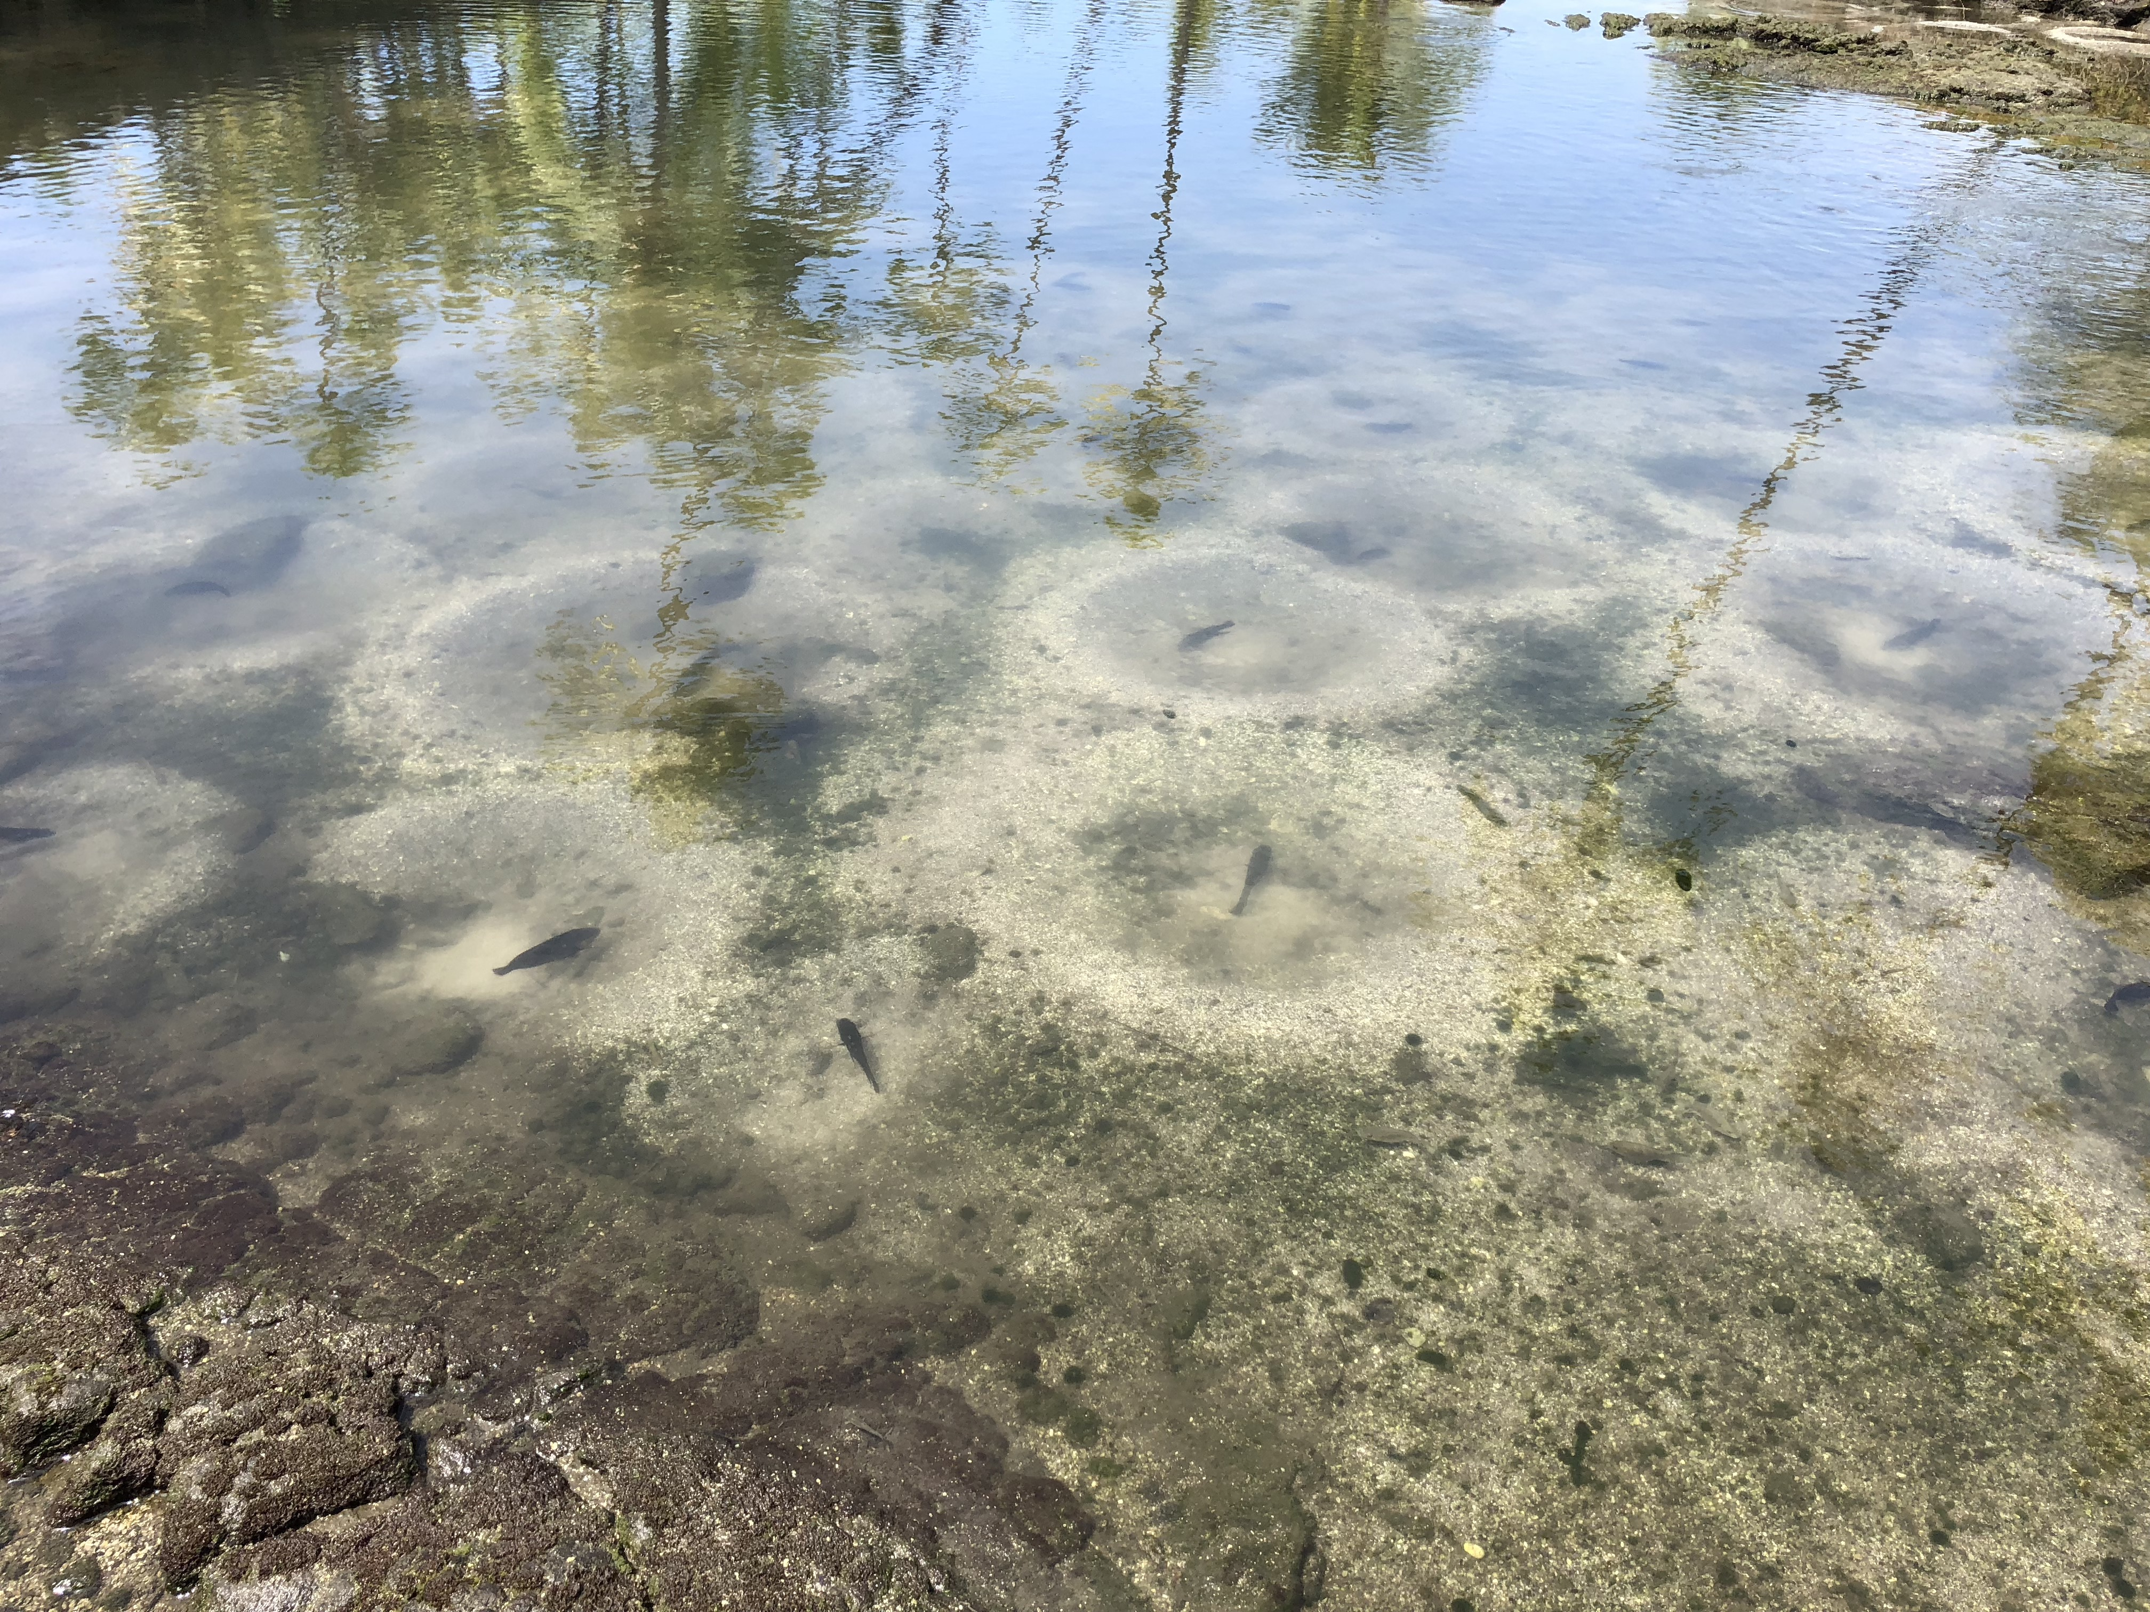

Slide 3
Pre-match
Orientation of Matching process
Letters of recommendation
United States clinical experience
Involvement with AAN or other Medical Societies
Communication with ECFMG

Slide 4
Post-match
Electronic Medical Record training
Recognition of prior training
Mentorship
Reporting System
Social and religious involvement- Mind-Body and Soul

Slide 5
Residency and fellowship
Managing difficult scenarios- colleagues, patients, community
Research Orientation
Administrative opportunities
Quality improvement projects
Practice Habits

Slide 6
Pros and cons of residency at vanderbilt
Learning and teaching environment- coding beside routine medical learning
Interactions at all levels with opportunities to be involved
Professional Environment
Sub-specialist clinics -- interaction with patients with rare diseases e.g Huntington disease
Business lectures
Clinically driven with little time for research

Slide 7
Thank you
AAN and dear colleagues

