Slide 1
Promoting Diversity in Recruitment & Retention
Allison Brashear, MD, MBA
Professor and Chair, Department of Neurology
Walter C. Teagle Chair
Wake Forest School of Medicine
Winston Salem, NC

Slide 2
Three P’s
Pipeline
Purposeful;
Residents
Faculty
Tips Sourcing, Interview
Mistakes- Realtor
Promote
Why stay- Specific programs
Tips from elsewhere- how we can do better

Slide 3
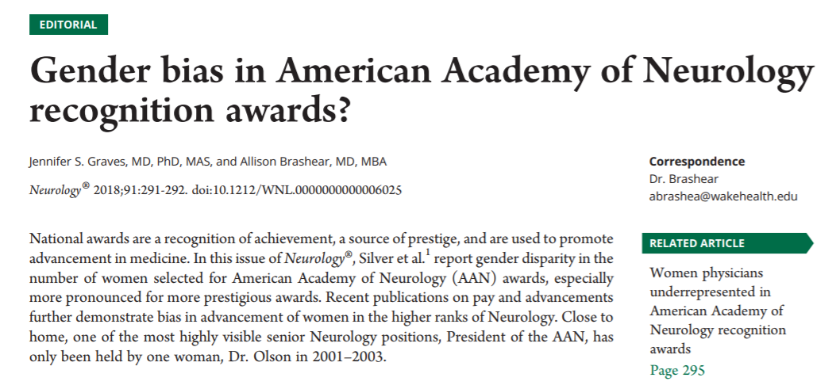
Be a champion and visible
How do your faculty know your values on diversity
Be a SPONSOR

