Slide 1
Preventing Burnout and Promoting Resilience Among our Trainees
Patrick S. Reynolds, MD, FAAN
Professor of Neurology
Associate Dean for Preclinical Education WFSOM
Former residency program director for 15 years…

Slide 2
Disclosures
None
All current research is NIH funded

Slide 3
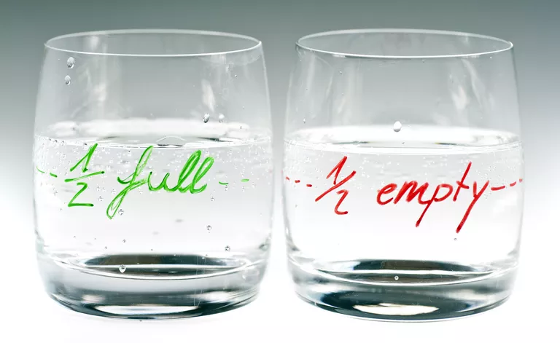
Hold that thought….

Slide 4
Outline
Setting the stage
Case studies
Burnout numbers
ACGME mandate
Practical suggestions
Resiliency and Grit

Slide 5
Case R – prior to duty hour restrictions
Internal medicine intern
On CCU service 1:3 call
Working long hours
Fell asleep driving home
No time to exercise
No time with friends
Angry at patients
Demeaned by attendings

Slide 6
Case B
PGY – 2 resident
Excellent evaluations in first CCC meeting
In space of 2 weeks got 4 patient relations complaints, one patient aspirated, got pneumonia, septic and died, another patient died unexpectedly from a procedural complications
Resident really feeling down and depressed

Slide 7


Burnout
Emotional Exhaustion
Depersonalization
Decreased sense of personal accomplishment
*** Basically you stop caring: about yourself, your patients and your future***
Burnout increases the risk of committing medical errors, having unprofessional interactions with patients, colleagues and co-workers, and increases rates of depression, substance abuse and suicide.
Notes:
Significant levels of emotional exhaustion or depersonalization
You stop caring: about yourself, your patients and your future!

Slide 8
What factors influence burnout?
Workload
Control
Reward
Community
Fairness
Values
Wellness
Increasing
Residents have no control
Mainly receive negative feedback
This is usually reasonable
Resident experiences are variable
Dichotomy between institutional mission statements and day to day actions
Perceived or actual lack of time for self care

Slide 9
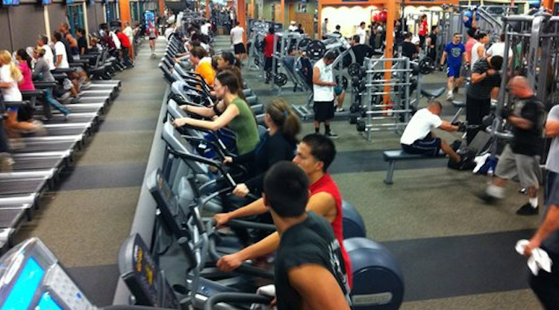

How to prevent Burnout?
Some institutions are looking for a quick fix.

Slide 10
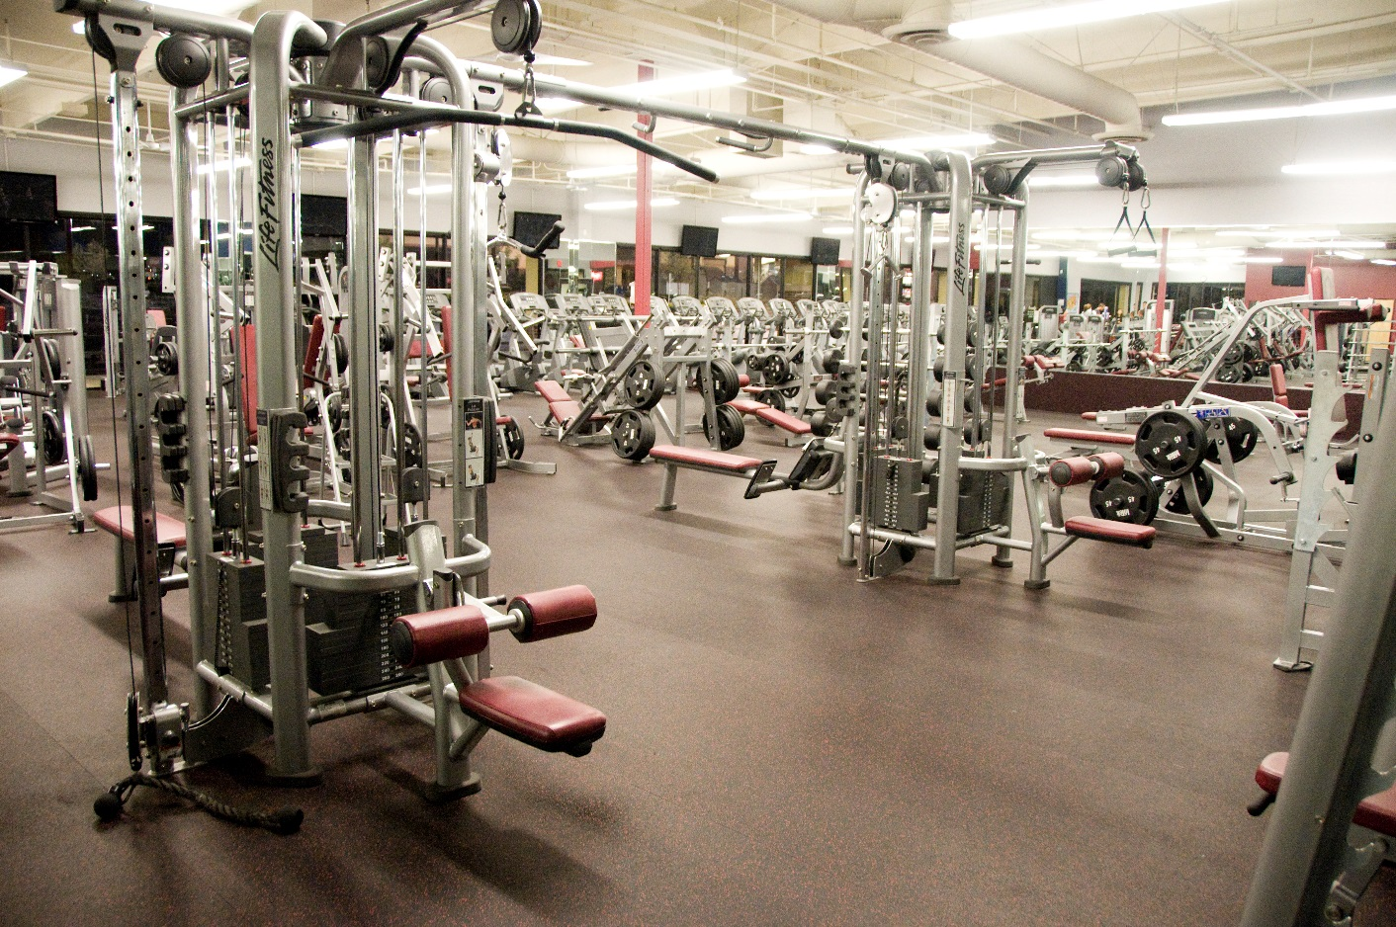
Burnout
Burnout is not simply a lack of wellness.
Simply promoting wellness does NOT eliminate burnout.

Slide 11
Burnout
Burnout (or failure to thrive) arises from a lack of resiliency when faced with adversity

Slide 12
So, what is the remedy for burnout?
Inverse of burnout = ENGAGEMENT!
  Positive state of fulfillment characterized by vigor, dedication and absorption

Slide 13
Resiliency
Resiliency is a state of being that promotes wellness and decreases the impact of physical and psychological stress
Resiliency is not a personality trait – it is a series of behaviors that promote engagement.
In Andrew Zolli’s book, Resilience, Why Things Bounce Back, he defines resilience as “the ability of people, communities, and systems to maintain their core purpose and integrity among unforeseen shocks and surprises.”

Slide 14
Resiliency and Grit
Grit is a personality trait:
  Dictionary: firmness of character, indomitable spirit
  Angela Duckworth: Grit is perseverance and passion for long-term goals

Slide 15
Grit
Teddy Roosevelt:
“It is not the critic who counts; not the man who points out how the strong man stumbles, or where the doer of deeds could have done better. The credit belongs to the man who is actually in the arena, whose face is marred by dust and sweat and blood; who strived valiantly; who errs, who comes again and again, because there is no effort without error and shortcoming; but who does actually strive to do the deeds; who knows great enthusiasms, the great devotions; who spends himself in a worthy cause; who at the best knows in the end the triumph of high achievement, and who at the worst, if he fails, at least fails while daring greatly.”

Slide 16
Grit
Duckworth: achievement is the product of talent and effort, the latter a function of the intensity, direction, and duration of one’s exertions towards a long-term goal
Talent does NOT equal grit

Slide 17
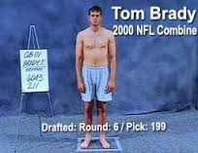
Grit – an example from the NFL
“lacks great physical stature and strength”
“a system-type player that could get exposed if forced to ad-lib”
“does not throw a tight spiral”
Drafted 6th round #199

Slide 18

Grit
5 Superbowl Wins
4 Superbowl MVPs
8 AFC Championships
3 NFL MVPs

Slide 19
Grit and the “Growth Mindset”
Grit enables and fosters a “growth mindset” (Carol Dweck)
  A belief that abilities are not fixed and that you can improve
  Failure is an opportunity to improve, not an indictment of your inadequacies
  Athletes in medicine as a potential example
Notes:
One study looked at surgical resident performance and found that 40% of residents in the top decile of the program participated in team sports in the past, compared to zero percent of residents in the bottom decile(Papp KK). Another study examined predictors of future success in otolaryngology residency applicants and found that “excellence in athletics” significantly correlated with superior faculty ratings of performance(Chole RA). A meta-analysis of 21 articles relating to pre-residency predictors of success in neurosurgical training found that while standardized test scores correlated poorly with faculty performance evaluations, athlete status had a much higher correlation with overall faculty evaluation (Zuckerman SL). Spitzer and colleagues found that residents who were varsity athletes in college were significantly more likely to be appointed chief resident compared to their non-athlete co-residents (Spitzer AM).

Slide 20
Promoting Resiliency
A strong resiliency framework is built upon
  Healthy adaptive emotional, cognitive, physical, social and spiritual characteristics

Slide 21
Promoting resiliency
Siebert’s resiliency model – 5 Key Principles
1. Managing your personal health
2. Problem Solving
3. Increasing self-strengths: self-esteem, self-confidence, and self-concept
4. Developing Positive Response choices
5. Learning good lessons from difficult situations
Siebert AL. The Resiliency Advantage. San Francisco, CA: Berrett-Kuehler Publisher, Inc; 2005.
Notes:
Siebert AL. The Resiliency Advantage. San Francisco, CA: Berrett-Kuehler Publisher, Inc; 2005.

Slide 22
Can we promote resiliency??
Or, how can we fight burnout?

Slide 23
Can we promote resiliency??
Mentoring, coaching, wellness programs
Beginning to be well-documented in the literature that mentoring and coaching programs can improve resident wellness and satisfaction
Runyan: Impact of a Family Medicine resident wellness curriculum
Adams: Resiliency Training for Medical Professionals
Zhang: Formal Mentorship in a surgical residency training program: a prospective interventional study

Slide 24
Promoting Resiliency
Palamara: Promoting Success: A Professional Development Coaching Program for Interns in internal Medicine

Slide 25
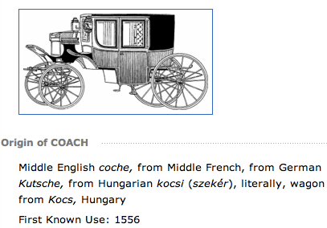

What exactly is coaching?
Takes a valued person from where they are to where they want to be – Old Webster Dictionary
Unlocks a person’s potential to maximize performance
NOT fixing people – helping them be their best selves
Identify strengths and use them to overcome barriers
Identify effective coping skills and how/when to employ them
Kerri Palamara, MD
kpalamara@partners.org

Slide 26
Heart of the MGH Coaching
Positive psychology
  Focus on the positive, not the negatives
    Glass half full !
  Try to identify and use the resident’s strengths and talents
  Set realistic goals

Slide 27

Enter the
Common Program Requirements July 2017: Wellness
Enhance meaning of being a physician
Attention to scheduling, work intensity, and work compression
Workplace safety
Time for personal health needs
Identification of burnout, depression, and substance abuse
Tools for self-screening
Mental health assessment, counseling, and treatment

Slide 28
How to determine a baseline for the problem?
Need to collect some data.
Multiple survey instruments out there

Slide 29
WF Baseline Burnout Data
GME office surveyed all of our residents.
Received responses from 396 residents/fellows
Response rate of 57%

Slide 31
Selected Questions from Burnout Survey, N = 396
Worried that work is hardening them emotionally | 73%
Often bothered by feeling down or depressed | 54%
Fallen asleep while stopped in traffic or driving | 13%
Felt overwhelmed by responsibilities | 70%
Work has changed or interfered with how they interact emotionally in their relationship | 65%
Work has prevented them from attending to their own personal health needs (medical or dental appointments, counseling, etc.) | 73%

Slide 32
Contributing causes of burnout identified by respondents
long hours/consequent shifts without adequate time off between shifts,
work-life imbalance contributed by several factors,
feeling unappreciated by staff and patients,
inadequate support and respect from faculty and/or other staff,
stress of the job itself (i.e. pressure not to make mistakes, overwhelmed with responsibility, being responsible for patients with complex illness, etc.),
inability to focus on education mission,
inflexible work schedules
additional responsibilities (i.e. notes, paperwork, EHR, scheduling/referrals, etc.), and
institutional/administrative barriers (i.e. staffing, clinic vs. education, financial priorities, etc.)

Slide 33
Barriers to seeking treatment/help with burnout
Time – ranging from inflexible work schedules, lack of personal time, to inability to take time off
Stigma around fear of what the licensing boards will think, being “looked down upon” or “considered weak”, feeling “guilty about taking time off from work”, or “everyone is experiencing it so why do I need treatment”
Resources – not being aware of resources, lack of support from institutional stakeholders, or personal financial burdens were identified as barriers in seeking resources
Culture of the program – “Understanding that residency is supposed to be difficult and straining”, “assuming it’s normal part of residency that all of us have to toughen through”, or “you survive it and move on”
• Self-imposed barriers – could be personal pride/ego, lack of motivation, or priorities

Slide 34
How can we meet the ACGME Requirements?

Slide 35
Common Program Requirements July 2017: Wellness
Your GME office should be working to provide institution-wide initiatives to help
Individual programs meet these requirements, but each program must demonstrate
How you are addressing these
Enhance meaning of being a physician
Attention to scheduling, work intensity, and work compression
Workplace safety
Time for personal health needs
Identification of burnout, depression, and substance abuse
Tools for self-screening
Mental health assessment, counseling, and treatment

Slide 36
Fighting burnout by promoting engagement

Slide 37
Influencing burnout
Workload
  Re-arrange rotations
  Addition of APPs
  Off-load some work to attendings

Slide 38
Influencing Burnout
Control
  Give residents control over their schedules
  Listen to resident feedback on improving rotations
  Allow residents input on conference scheduling and some content

Slide 39
Influencing Burnout
Reward
  Enhance Positive, real-time feedback
  Coaching residents to view positive aspects of their job and not just negatives

Slide 40
Influencing Burnout
Community
  Foster opportunities for resident interaction outside of the hospital
  Foster faculty-resident interaction and engagement
    Get to know the people behind the white coats
  Promote wellness, be a role-model

Slide 41
Influencing Burnout
Fairness
  Ensure equitable rotation distribution
  Mentorship and coaching for all

Slide 42
Influencing Burnout
Values

Slide 43
Case study resolutions
Case R
Case B

Slide 44
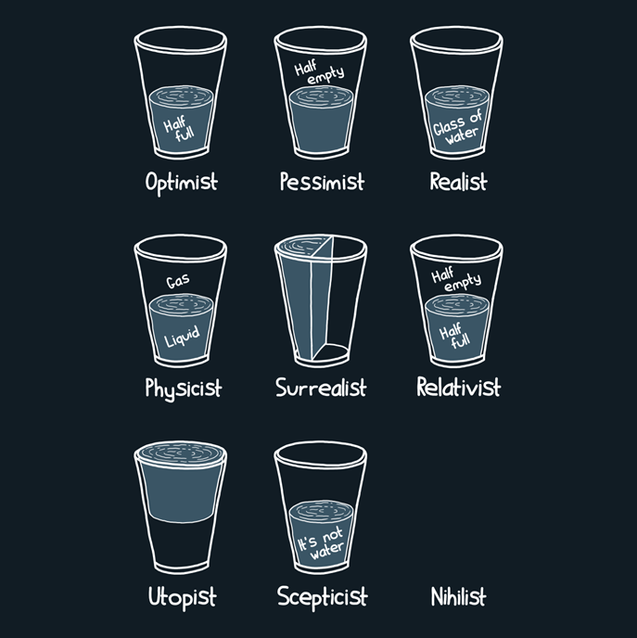
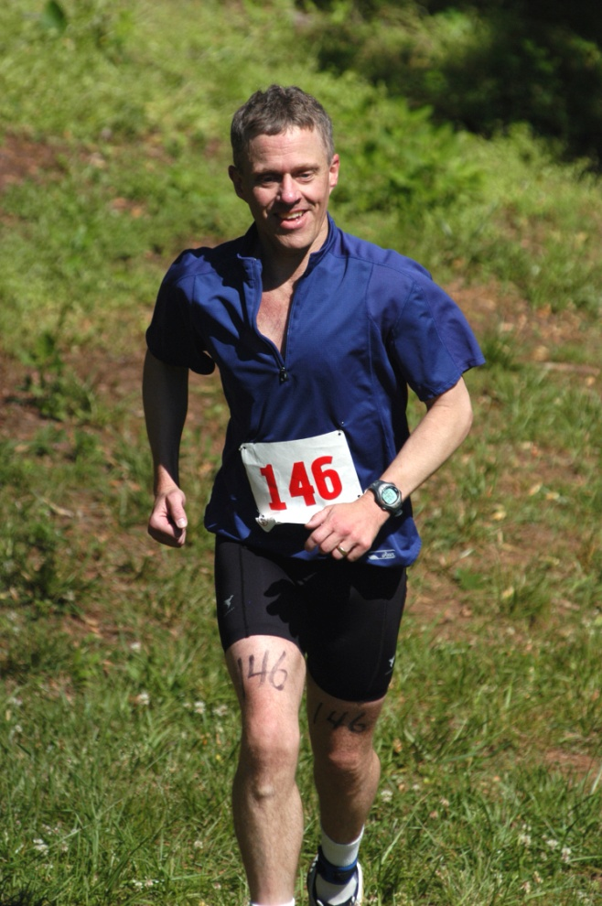
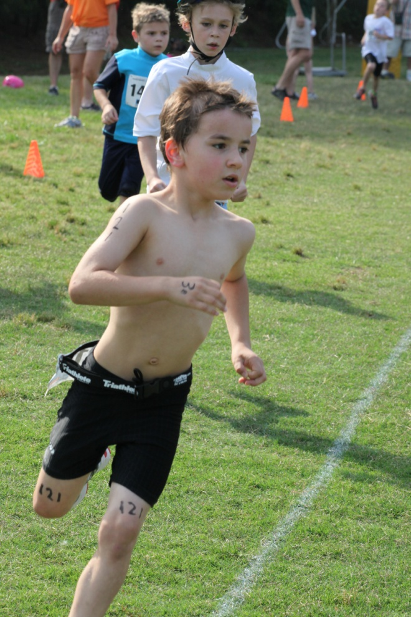
Questions?
My first triathlon
Ryan’s first triathlon

