Slide 1


Faculty Wellness and Burnout
L. John Greenfield Jr., MD, PhD
Professor and Chair of Neurology

Slide 2
Disclosures
None relevant to this presentation
Palatucci Leadership Forum
Clinical research support from Sunovion

Slide 3
The Problem
“Dear Dr. Greenfield,
I regret to inform you that after considerable deliberation, I have decided that I will not plan to renew my contract with UConn Health in July 2018.
My first year of trying to build a successful Multiple Sclerosis program at UConn Health was met with many challenges. Some of the challenges were institutional, others departmental, and some personal. I accepted the MS position at UConn Health with the belief that the work/life balance would be better than the many competing offers. I must attest that my current perception is a different reality. When completing documentation means sacrificing the opportunity to see my son grow up, the result has been delayed documentation and losing my weekends to charting. From a personal perspective, bringing a child into our family has brought about the realization that we need to be closer to family if I am to sustain working in a position as demanding as my current job.…”

Slide 4
A Not-So-Silent Epidemic
Nationwide, up to 50% of practitioners suffer symptoms of burnout
  Annual 2018 Medscape* study: 42% report burnout
    Higher in women (48%) than men (38%)
    Increased with age: 35% at age 28-34 → 50% at age 45-54
  Associated with depression
    12% report mild depression (“feeling down”)
    3% severe clinical depression (MDD)
      6.7% of adults suffered depression last year
  For neurologists, 48% report burnout
    Among specialties with highest burnout rate
    17% of neurologists report both depression and burnout
* https://www.medscape.com/slideshow/2018-lifestyle-burnout-depression-6009235#2

Slide 5
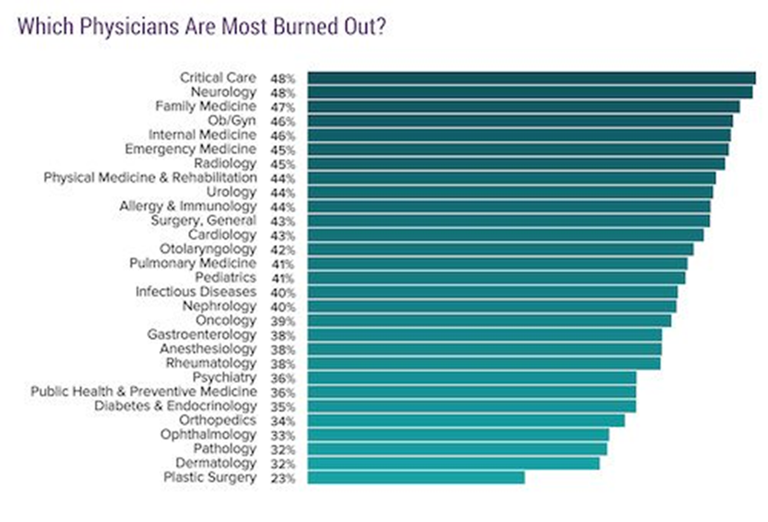
https://www.medscape.com/slideshow/2018-lifestyle-burnout-depression-6009235#3

Slide 6

Burnout Defined
  Loss of the feeling that one’s work is important, valued and meaningful
  “An erosion of the soul caused by a deterioration of one's values, dignity, spirit, and will.”*

Slide 7
Symptoms of Burnout
Emotional Exhaustion:
  Loss of emotional resources
  Unable to deal with patient and work demands
Depersonalization:
  Devaluation of individuals
    Loss of empathy for patients as people
  Viewing patients as “cases” or diseases
  Need to vent about patients or work
    Cynicism, sarcasm, “war stories”
Decreased Career Satisfaction
  Doubting the meaning and quality of work
  Fear of mistakes and their consequences

Slide 8
Impact of Burnout*
  Damage to relationships (clinical & personal)
  Lower patient satisfaction
  Lower quality of care, increased medical errors
    Higher malpractice risk
  Decreased productivity
  Career dissatisfaction
  Higher physician and staff turnover
  Depression & alcohol/substance abuse
  Physician suicide
*Drummond D. Fam Pract Manag. 2015 Sep-Oct;22(5):42-47

Slide 9
Suicide and Burnout
A doctor commits suicide in the U.S. every day¹
  highest suicide rate of any profession
    28 to 40 per 100,000
  more than twice that of the general population
    12.3 per 100,000.
Variety of causes (P. Wible):
  emotional stress, long work hours, sleep deprivation, bullying/hazing, “assembly-line medicine,” pressure to produce RVUs, patient deaths, malpractice suits, academic failures, etc.
  “On-the-job post-traumatic stress disorder”²
  The term “burnout" shifts blame to doctors for their emotional distress, deflecting attention from unsafe working conditions
  Loss of physicians is a public health crisis
1. https://www.webmd.com/mental-health/news/20180508/doctors-suicide-rate-highest-of-any-profession#1
2. https://www.washingtonpost.com/national/health-science/what-ive-learned-from-my-tally-of-757-doctor-suicides/2018/01/12/b0ea9126-eb50-11e7-9f92-10a2203f6c8d_story.html?noredirect=on&utm_term=.382b1d631f7c

Slide 10
Impact of Academic Burnout
Effects magnified in the academic setting
  Reduced clinical and academic productivity
  Loss of potential lifesaving research
  Loss of innovation in patient care delivery
  Cascading effect of poor satisfaction on the training of students, residents and fellows
    Modeling callous attitude and “bad behavior”
Worse for academic physicians?
  additional burdens of research, writing papers and grants, administrative duties and teaching

Slide 11
Possible Causes of Burnout
Stresses of Clinical Medicine
  High level of responsibility
  Little control over work conditions, patient outcomes and satisfaction
Inefficient Systems of Care
  Tight scheduling, pressure to see more patients
  Patients arrive late and disrupt flow
  EMR is time-consuming; the unrelenting “last patient”
  Preauthorization for tests & medications, institutional scheduling policies undermine autonomy
Poor Work/Life Balance
  Charting deferred to nights/weekends
  Patient phone calls, refills, questions prolong workday
  Little protected time for education, research

Slide 12
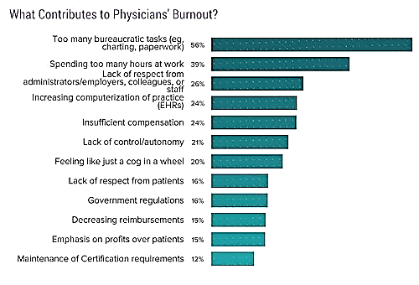
https://www.medscape.com/slideshow/2018-lifestyle-burnout-depression-6009235#13

Slide 13
The ReBICS Study at UConn
Reducing Burnout and Increasing Career Satisfaction Study
  What is the impact of clinician burnout in an academic medical center?
  Survey of UConn Health academic clinicians with at least 10% clinical effort
  Questions included abbrev. Maslach Burnout Inventory and UConn-specific questions

Slide 14
Maslach Burnout Inventory (Abbreviated) – MBI-9
Maslach C, et al. The Maslach Burnout Inventory. 3rd ed. 1996
PA
D
EE
EE
D
PA
EE
D
PA

Slide 15
Scoring the MBI-9
PA
D
EE
Personal Accomplishment
  > 14 low, 13-14 moderate, <13 high burnout
Depersonalization
  <4 low, 4-6 moderate, >6 high burnout
Emotional Exhaustion
  <7 low, 7-10 moderate, >10 high burnout

Slide 16
Additional Questions
Demographics and personal situation/ habits
  Exercise, sleep, child care responsibilities
Work hours and work type allocations
  Clinical, teaching, research, administration
Satisfaction with and importance of work conditions
Open-ended questions/comments

Slide 17
Demographics
Total of 128 with sufficient data for scoring
  70 women (52.6%), 63 men (47.4%)
  65% have dependent children or parents
  91% married/living with long term partner
  83% had hobbies/regular fun activities

Slide 18
aMBI Results
Burnout Levels | Accomplish-ment | Depersonal-ization | Emotional Exhaustion
 | n=123 | n=125 | n=128
Mean (SD) | 15.1 (2.5) | 5.0 (2.7) | 9.0 (4.2)
Low Burnout | 83 (67.5%) | 53 (42.4%) | 43 (33.6%)
Moderate | 21 (17.1%) | 41 (32.8%) | 37 (28.9%)
High Burnout | 19 (15.5%) | 31 (24.8%) | 48 (37.5%)
32.5% of respondents had moderate to high burnout in PA
57.6% had moderate or high burnout on Depersonalization
66.4% had moderate or high burnout on Emotional Exhaustion

Slide 19
Demographics and Burnout
No association between Burnout indices and:
  having children
  being married vs single
  having hobbies (most do)
Mild association with gender
  Men had lower EE than women (p = 0.05)
Primary caregivers had higher EE (p = 0.05)
ReBICS did not ask age
  no correlation with years in practice
  no correlation with years at UConn Health.

Slide 20
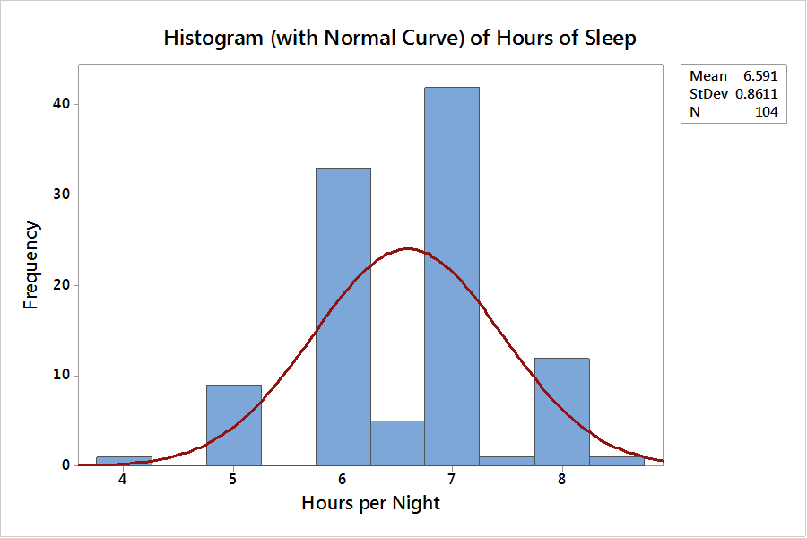
Sleep
Less sleep associated with increased EE (p = 0.05)
Sleep hours: Median 7, Mean 6.59 ± 0.86

Slide 21
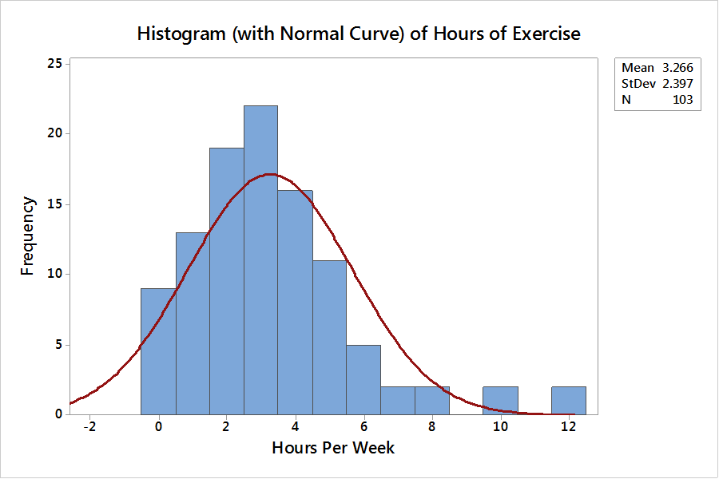
Exercise
Less exercise assoc. with ↑ EE (p = 0.02)
Median of 3 hours of exercise per week (3.27 ± 2.4, mean ± SD)

Slide 22
Lack of Sleep - Cause or Effect?
Is lack of sleep the result of work demands?
  Or a separate contributor to burnout?
Does burnout cause depression that impairs sleep?
  Or does sleep loss cause depression?

Slide 23
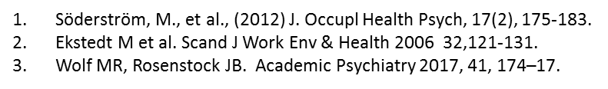
Sleep loss causes burnout
Insufficient sleep predicts burnout¹
  < 6 h sleep was main risk factor for B in 15 of 385 subjects identified as being burned out
Burnout is associated with sleep disturbance²
  PSGs of people with B show ↑ sleep fragmentation, more wake and Stage 1 time, lower sleep efficiency, less slow wave and REM sleep, lower delta power in NREM sleep
Inadequate sleep and exercise associated with burnout and depression among medical students at Univ. of Pittsburgh³
  Positive depression screening, pathological sleepiness, and sleeping less than 7 h a night were independent predictors of burnout
  Decreased exercise frequency was significantly correlated with lower professional efficacy

Slide 24
Consequences of Sleep deprivation
  Poor medical decision-making associated with sleep deprivation
    Increased risk of sharps injury, MVA on drive home, medical errors¹
    36% more serious medical errors, 300% more errors that lead to a patient’s death
    Libby Zion case (1984) a key factor in limiting resident work hours
Lockley SW et al, J Commision J Quality Patient Safety 2007 33: 7-18

Slide 25
UConn Burnout Questions
“Documentation makes me consider quitting medicine:”
  26% > few times per week
  Highly correlates with ↑ D, ↑ EE
“Boards/MOC requirements bother me:”
  20% > few times a week
  Correlated with EE burnout
“I think of leaving medicine for another career:”
  16% > a few times a week
  Highly correlated with ↑D and ↑ EE, ↓ PA

Slide 26
Academic Pursuits
Academic pursuits correlate with lower burnout
  “I enjoy teaching students/residents:”
    80% > few times a week
    Correlates with ↑ PA, ↓ EE
  “I enjoy research, writing papers/grants:”
    22% > weekly
    Either don’t enjoy doing research or don’t have the opportunity
  “I regret going into academic medicine:”
    3% > weekly
    Correlated with worse D, EE

Slide 27

Satisfaction
High satisfaction scores correlated with lower burnout scores:
  “I feel satisfaction with being a clinician”
    (80% > weekly)
  “I find work meaningful and satisfying”
    (69% > weekly)
  “I feel my work is appreciated”
    (54% > weekly)

Slide 28
Satisfaction, cont.
High satisfaction with other academic/clinical work parameters also negatively correlated with burnout indices:
  flexibility of schedule
  latitude to pursue areas of interest
  improvement of knowledge/skills
  academic success and promotion,
  mentorship,
  effective communication from leadership,
  support of personal wellness
  recognition for accomplishments
No relationship between satisfaction with salary or UCHC reputation and measures of burnout (!?)

Slide 29

Engagement
“I have confidence in UConn as an institution”
  39% > weekly
  More confidence associated with ↓EE
  Institutional engagement lags other measures of work satisfaction.

Slide 30
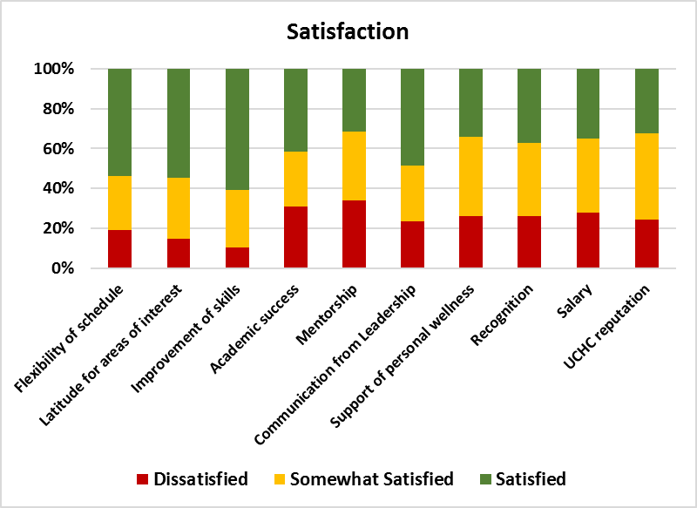
Academic Issues: Satisfaction
No obvious areas of greater dissatisfaction.

Slide 31
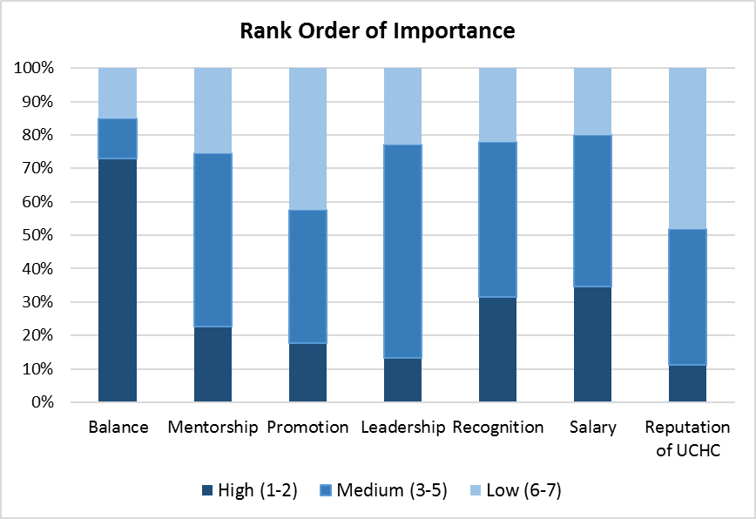
Academic Issues: Importance
Work/Life balance, Salary and Recognition ranked high in importance;
Promotion, Leadership and UCHC reputation rank lower.

Slide 32
Academic Contributors to Burnout?
Academic physicians divide effort among missions
  Clinical, research, education, administration
Hypothesis: dissatisfaction may arise from misallocation of effort among missions
  i.e. faculty would be happier spending more time doing the things they prefer to do
We asked faculty for their ideal % effort in each mission and compared to actual reported effort by mission
  Difference between these is Effort Mismatch

Slide 33
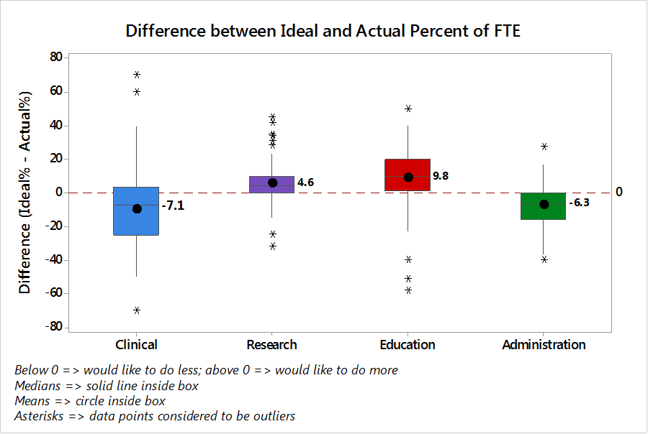
Alignment of Effort
~ 75% of respondents would like to do less Clinical or Administrative work
~ 75% would like to do more Research and Education.

Slide 34
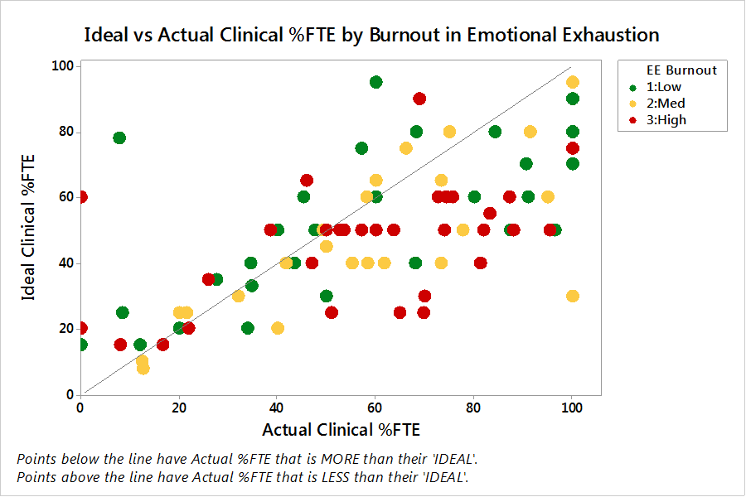


Effort Mismatch vs. EE: Clinical
If EE associated with mismatch, points farther from the diagonal line should have > EE (yellow or red).
If higher clinical effort contributes to EE, points to the right should be have more EE (yellow/red). Neither trend is obvious.

Slide 35
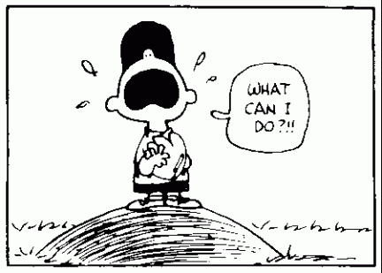
Mitigating Burnout

Slide 36
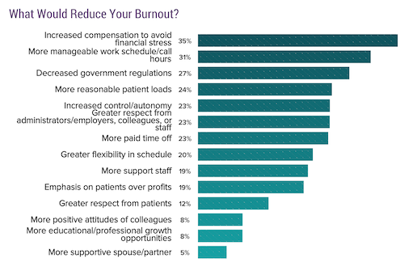
https://www.medscape.com/slideshow/2018-lifestyle-burnout-depression-6009235#14

Slide 37
No EasyTop-Down Solution
Institutions reluctant to increase salaries, reduce RVU targets, shorten work hours, add support personnel due to already tight bottom line
Ever-changing regulations are designed to delay/deny service to reduce cost – difficulty is intentional
Modern EMRs are powerful but reflect complexity of modern health systems → lots of clicks
Mandated burnout programs (exercise, support groups, counseling, coaching) are yet another time-consuming obligation, may inadvertently worsen burnout
  Any solution needs to bolster individual autonomy/efficacy

Slide 38
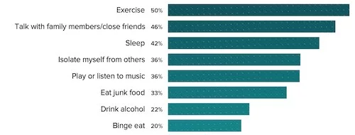
How do you cope with burnout?
Adaptive responses
  Exercise, sleep, music, talk with friends/family
Maladaptive responses
  Isolation, overeating or poor diet, alcohol abuse
https://www.medscape.com/slideshow/2018-lifestyle-burnout-depression-6009235#15

Slide 39
Exercise and Burnout
Aerobic exercise may improve burnout
  In 12 male participants with high MBI, a 12 week exercise program reduced perceived stress and sx of burnout and depression¹
  12 week exercise program for residents at Mayo Clinic in 2011 improved QOL with marginal effect (24% vs 29%) on B²
Exercise may also improve sleep quality/quantity
Gerber M et al., BMC Research Notes 2013, 6:78
Weight CJ et al., Mayo Clin Proc 2013 88:1435-1442

Slide 40
Changing your Organization
“Reducing burnout and promoting engagement are the shared responsibility of individual physicians and health care organizations”*
  Organizational factors are the primary drivers of physician burnout
  “Managing the problem” with stress management workshops, resilience training, coaching neglects systemic drivers of burnout
    Treats the symptom, not the cause
    Seen as insincere effort to shift blame onto individual
*Shanafelt and Noseworthy, Mayo Clin Proc. 2017;92(1):129-146

Slide 41
Strategies for Leaders
Acknowledge and Assess the Problem
Model the behaviors you want to see
  Demonstrate engagement, positivity, teamwork
Recognize unique talents of individual physicians and what motivates them
  Physicians who spend >20% effort on the work dimension they find most meaningful are at greatly lower risk of burnout¹
Align faculty effort with preferred activities
  Assess and reward success
  Redirect when outcomes not optimal
1. Shanafelt TD,, et al. Arch Intern Med. 2009;169(10):990-995.

Slide 42
Strategies, cont.
Align institutional and individual values
  “The patient comes first” should not be at expense of the physician
Promote flexibility and work-life integration
  High work hours expected in medicine make it difficult for physicians to integrate personal and professional lives.
  May be even more problematic for women physicians due to different cultural and societal expectations
  Reducing/restructuring work hours can help physicians recover from burnout.¹
Provide resources to promote resilience and self-care
  Confidential counseling, coaching, resilience training
  Important not to shift blame for burnout onto individual
1. Shanafelt TD, et al. Mayo Clin Proc. 2016;91(7):836-848.

Slide 43
Salary structure
Use rewards/incentives wisely
  Incentive pay (above base salary) for extra productivity motivates additional effort, may improve satisfaction
    Security of adequate base salary = safety
  Pure incentive with most of salary at risk creates stress, incentivizes long hours that lead to burnout
  Non-financial rewards (protected time, greater flexibility) may increase satisfaction/fulfillment
“Doctors fare better in organizations where they are not compensated for individual productivity, are not under time stress, have more control over clinical issues, and are able to balance family life with their work.”
  (AHRQ grant HS00032)

Slide 44
EMR
Physicians spend ~ 33% of their work hours performing direct clinical work and 49% completing clerical tasks and interfacing with the EMR¹
  For every hour of clinical work, physicians spent 2 hours on clerical work or EMR tasks²
  Time for charting not built into clinic schedules, often spills over to nights/weekends
  Harder on older physicians, less tech-savvy
Develop strategies to use technology for good
  Templates, smart phrases, speech-to-text (Dragon/Fluency)
  Precharting prior to visit can reduce clinic day stress
Scribes can increase productivity, reduce stress/burnout
1.Sinsky C,, et al. Ann Intern Med. 2016; 165(11):753-760
2. Shanafelt et al., JAMA 2017, 317:901-902

Slide 45
Interventions
Develop targeted interventions
  identify local factors that could be rapidly altered to improve physician burnout and satisfaction
  Look for “low-hanging fruit” – things everyone agrees need to be fixed and don’t cost much
  Physicians must participate in designing change
Cultivate Community at Work
  Celebrate achievements, support peers through challenges, mentorship, shared learning experiences and down time (lounges, cafeteria spaces)
  Support culture, arts, sports, conversations, “life at work”
  Design workspaces that foster interactions

Slide 46
Studied Interventions
From AHRQ-funded Healthy Work Place Study:
  Monthly provider meetings focused on work life issues
  Diabetes and depression screening QI projects to engage office staff, enhance team work, and reduce the pressure on physicians
  MA’s enter data into EHR, track forms, send faxes.
  Creating PCMH, ↓ panel size (# pts), flexibility for longer pt visits, ↑ support staff

Slide 47
Other Ideas
Creating standing order sets.
Providing responsive information technology support.
Reducing required activities.
Providing time in the workday to complete documentation tasks and enter data into the EHR.
Offering flexible or part-time work schedules.
Having leaders model and support work-home balance.
Hiring floating clinicians to cover unexpected leave.
Building workplace teams that address work flow and quality measures.
Ensuring values align between clinicians and leaders
https://www.ahrq.gov/professionals/clinicians-providers/ahrq-works/burnout/index.html

Slide 48
Resources
AMA STEPS Forward™ collection has five professional well-being modules:
  https://www.stepsforward.org/modules/joy-in-medicine
American College of Physicians
  www.acponline.org/about-acp/chapters-regions/united-states/new-mexico-chapter/physician-burnout-and-wellness-information-and-resources
Institute for Healthcare Improvement: IHI Framework for Improving Joy in Work
  http://www.ihi.org/resources/Pages/IHIWhitePapers/Framework-Improving-Joy-in-Work.aspx?gclid=Cj0KCQjw3ebdBRC1ARIsAD8U0V4lREOjFqqYY6VdVnq4EbfT_LTnz048NRnDGewYQHY3HdcnC3hVuc8aAvXaEALw_wcB
Specialty Association resources
  AAFP: https://www.aafp.org/about/constituencies/resources/new-physicians/burnout.html
  ACEP: https://www.acep.org/globalassets/uploads/uploaded-files/acep/clinical-and-practice-management/resources/wellness/burnout-resources_062315.pdf
  AAN: https://www.aan.com/tools-and-resources/practicing-neurologists-administrators/career-articles/why-are-neurologists-burned-out/
AHRQ Research Funding:
  https://www.ahrq.gov/professionals/clinicians-providers/ahrq-works/burnout/index.html
Other:
  The Happy MD: https://www.thehappymd.com/
  KevinMD.com: https://www.kevinmd.com/blog/
  Helpguide.org: https://www.helpguide.org/
  Stressremedy.com: https://stressremedy.com/
  MedEdWeb: https://www.mededwebs.com/blog/well-being-index/7-resources-for-physicians-suffering-from-burnout

Slide 49

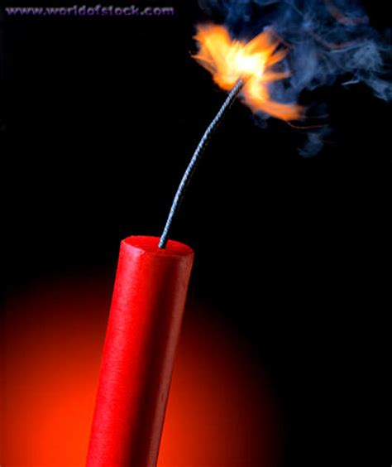
Your Career: Candle or Fuse?

Slide 50

Not this

Slide 51
References
Shanafelt TD, West C, Zhao C, et al. Relationship between increased personal well-being and enhanced empathy among internal medicine residents. J Gen Intern Med. 2005;20(7):559–564.
Firth-Cozens J, Greenhalgh J. Doctors' perceptions of the links between stress and lowered clinical care. Soc Sci Med. 1997;44(7):1017–1022.
Shanafelt TD, Bradley KA, Wipf JE, Back AL. Burnout and self-reported patient care in an internal medicine residency program. Ann Intern Med. 2002;136(5):358–367.
Williams ES, Skinner AC. Outcomes of physician job satisfaction: a narrative review, implications, and directions for future research. Health Care Manage Rev. 2003;28(2):119–139.
Gardiner M, Sexton R, Durbridge M, Garrard K. The role of psychological well-being in retaining rural general practitioners. Aust J Rural Health. 2005;13(3):149–155.
Wetterneck TB, Linzer M, McMurray J, et al. Worklife and satisfaction of general internists. Arch Intern Med. 2002;162(6):649–656.

Slide 52
