Slide 1
Building a Culture of Academic Excellence in a Rural Medical Center
Gregory L. Holmes, MD
Department of Neurological Science
Larner College of Medicine
University of Vermont

Slide 2
This is a fraudulent lecture. I suspect most people in this room are doing a
far better job running their department than me. I probably can tell you
more about what does not work as opposed to what does work.
Data Safety Monitoring Board
Eisai
UCB
Zogenix
NHLBI
Research Support
NINDS
NIMH

Slide 3
Siddhartha Mukherjee

Slide 4
Siddhartha Mukherjee
The anatomy lab was always freezing. This was our first course as medical students, and we had split our ourselves into groups – four students to every cluster. Each of us carried a copy of “Netter’s Anatomy”; by the end of three months in the lab, the volume would become chemically yellowed by formaldehyde, and to leaf through the tawny, crackling pages would be to feel your fingers becoming slowly embalmed.

Slide 5
Siddhartha Mukherjee
As the weeks drew on in that first year, we began to hear about residents, fellows and even senior doctors who had packed their scalpels and stethoscopes and left medicine. It was the late 1990s , and medical practice was just beginning to be assaulted by a thousand surgical cuts. Hospitals were changing to electronic medical records, and – although EMR had been sold to us as a means to ease work flow and to ensure patient safety (and yes, it did achieve these)- a doctor’s day felt more robotic and dehumanized: The residents in the wards seemed to spend the bulk of their time documenting notes, checking off codes and pressing buttons to generate automated bills. One night, as I recall, I overheard a young women resident breaking down in tears, her face silhoutted against the sharp light of the terminal as she typed manically. “I have spent two nights in the hospital and I haven’t even touched a patient. This is not what I came here to do.”

Slide 6
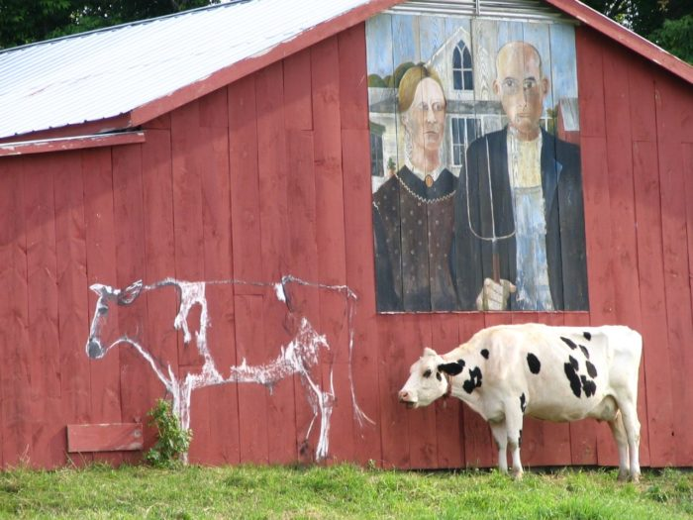
Department of Neurological Sciences at UVM
Department formed 6 years ago as a merger of the Department of Anatomy and Neurobiology with Department of Neurology.
Three academic pathways:
Clinical Scholar
Education Scholar
Tenured
Research Scholar
The College of Medicine is on the campus of UVM.
Burlington has 42,000 people; the state of Vermont has 600,000.
Closest metropolis is Montreal which is about a 90 minute drive.

Slide 7
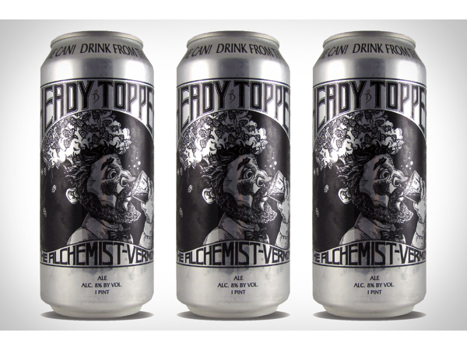
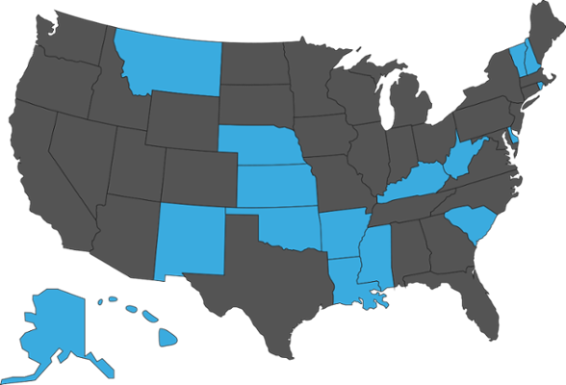
Challenges and Opportunities of a Small, Rural Medical School in Vermont
Disadvantages
Emphasis on primary care
Lack of competition
Limited sub-specialty depth
Low salaries
Difficult recruiting
Extremely low state support
Bias against small institutions
Philanthropy
Advantages
Work-life balance
Great beer
Relatively small faculty allows one to know their colleagues
Collegiality
“We do more with less” attitude
Institutional Development Award (IDeA) Program

Slide 8
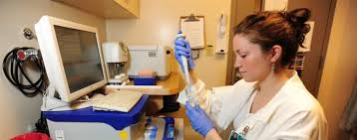
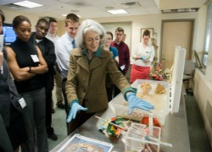
N = 32
N = 12
N = 8

Slide 9
Teaching
Patients
Research

Slide 10
Keeping the faculty engaged: There is more to Neurology than the Clinic
Research is integrated into all aspects of our program
Clinical faculty teaming with research faculty
Graduate students teaming with neurology residents
Clinicians/researchers attend same conferences
Mini-retreats where both research and basic research is presented
Education
The Teaching Academy sustains and supports an interdisciplinary community of educators who value the scholarship of teaching and learning while facilitating educator development
Faculty receive compensation for teaching
Advocacy

Slide 11
Department of Neurological Sciences

Slide 12
Department of Neurological Sciences

Slide 13
Department of Neurological Sciences

Slide 14
Department of Neurological Sciences

Slide 15
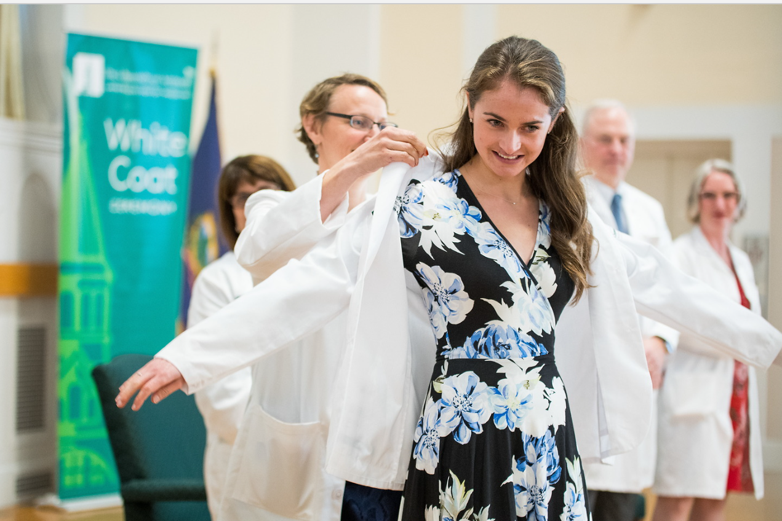

Slide 16
Neurological
Sciences
Graduate Program in Neuroscience
College of Medicine Departments
Other Medical Schools (Dartmouth)
Undergraduate
Departments

Slide 17
Recommendations
Partner with basic science departments
Engage with curriculum committee
Embrace collaboration across departmental lines
Keep on top of your department mentors
Matching mentor to mentee is critical
Mentorship should go beyond the workplace
Utilize mentors from other departments
Share resources
Emphasize research and teaching at every opportunity you can

Slide 19
Siddhartha Mukherjee
Some solutions to fixing burnout are therefore pragmatic. They involve lessening burdens; removing paperwork that does not positively affect patient care, lightening bureaucracies and dissolving the form-filling, diagnosis-coding, button-pushing culture of modern medicine. But the solutions suggested by our anatomy group – an informal, minuscule, far-from-scientific survey – involve more work. We survived, I think , by deepening our commitments to research. We tried to increase our mastery within peculiar medical niches. And powerful, autonomous interests kept us going. The mysteries of metastasis, the intractability of anxiety disorders and strange new disease of blood cells kept our brains and souls alive when the hospital was asking us to punch numbers into terminals. We didn’t burn out, perhaps, by burning a little more.

Slide 20
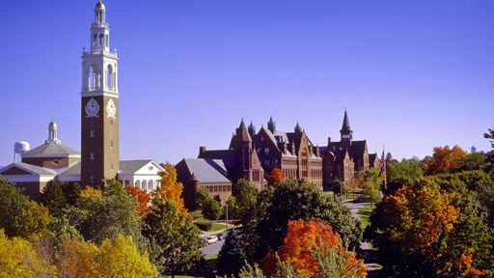
Discussion

