Slide 1
Mentoring Throughout the Education Continuum
Special Interest Group in Education
American Neurological Association Annual Meeting
October 2018

Slide 2
Objectives
Recognize the current literature regarding mentoring of students, residents and faculty developing within neurology.
Identify the needs of mentees across the academic spectrum within neurology.
Compare mentoring strategies used at institutions with the goal of developing formalized mentoring programs at academic institutions.

Slide 3
Why mentor?
Associated with a higher level of career satisfaction and a higher rate of promotion, both in medical and non-medical fields
foster the development of professionalism
enriching contact between residents and faculty physicians
Schapira et.al. JGIM 1992.
Reynolds P. Ann Int Med 1994.

Slide 4
Mentoring
long-term relationship with a responsibility to provide the support, knowledge, and impetus that can facilitate professional success.
a personal process that combines role modeling, apprenticeship and nurturing
serves to facilitate both personal and professional development
Ricer. Fam Med 1998.

Slide 5
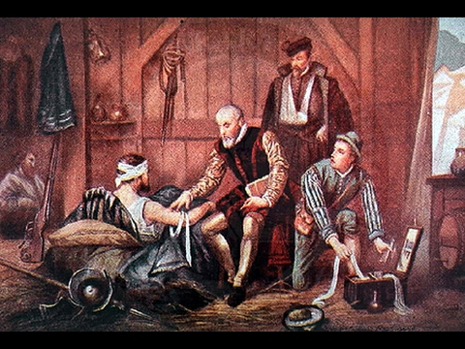

Slide 6
Who mentors?

Slide 7
Mentoring
a relationship in which a more experienced or more knowledgeable person helps to guide a less experienced or less knowledgeable person.
5 common methods:
Accompanying
Sowing
Catalyzing
Showing
Harvesting
Notes:
Accompanying: making a commitment in a caring way, which involves taking part in the learning process side-by-side with the learner.
Sowing: mentors are often confronted with the difficulty of preparing the learner before he or she is ready to change. Sowing is necessary when you know that what you say may not be understood or even acceptable to learners at first but will make sense and have value to the mentee when the situation requires it.
Catalyzing: when change reaches a critical level of pressure, learning can escalate. Here the mentor chooses to plunge the learner right into change, provoking a different way of thinking, a change in identity or a re-ordering of values.
Showing: this is making something understandable, or using your own example to demonstrate a skill or activity. You show what you are talking about, you show by your own behavior.
Harvesting: here the mentor focuses on "picking the ripe fruit": it is usually used to create awareness of what was learned by experience and to draw conclusions. The key questions here are: "What have you learned?", "How useful is it?".

Slide 8
Urgency!
Resident Burnout
training in urology, neurology, emergency medicine, and general surgery were significantly associated with higher RRs of reported symptoms of burnout during the second year of residency
clinical specialty areas with the highest prevalence of resident physicians experiencing symptoms of burnout mirrored those of practicing physicians to a large extent.
Shanafelt et.al. Arch Int Med 2012
Dyrebye et.al. JAMA 2018

Slide 9
Yehia et.al. BMC Medical Education 2014.

Slide 10
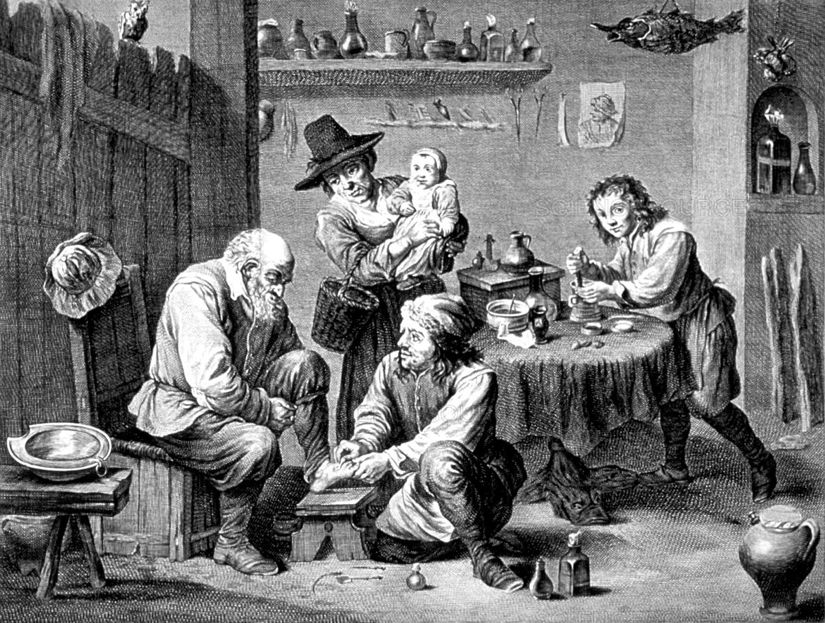

Slide 11
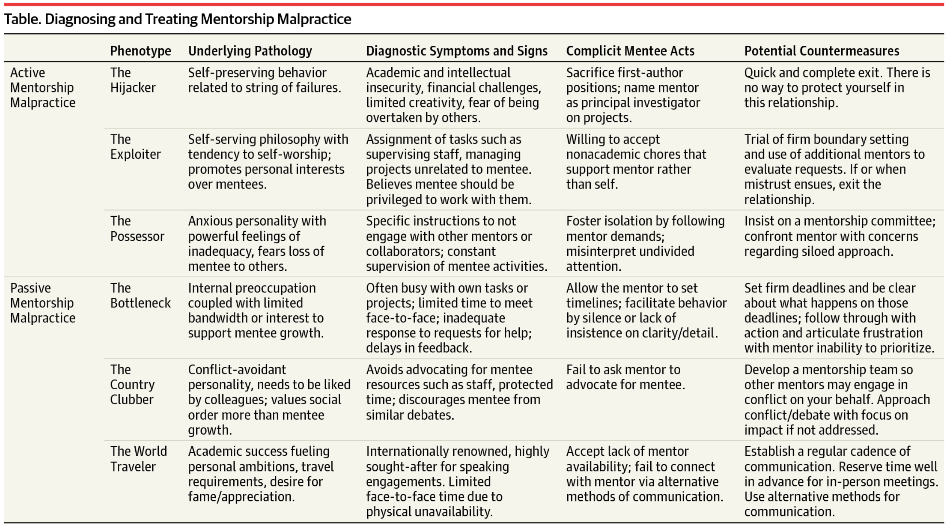
Mentoring Malpractice
JAMA. 2016;315(14):1453-1454. doi:10.1001/jama.2015.18884
Date of download: 4/13/2016
Copyright © 2016 American Medical Association. All rights reserved.

