Slide 1
Mentoring in Residency
Charles C. Flippen II, MD
Residency Program Director
David Geffen School of Medicine at UCLA

Slide 2
Disclosures
Nothing that is relevant to this presentation.

Slide 3
Why mentor?
Associated with a higher level of career satisfaction and a higher rate of promotion, both in medical and non-medical fields
foster the development of professionalism
enriching contact between residents and faculty physicians
Schapira et.al. JGIM 1992.
Reynolds P. Ann Int Med 1994.

Slide 4
Urgency!
Resident Burnout
training in urology, neurology, emergency medicine, and general surgery were significantly associated with higher RRs of reported symptoms of burnout during the second year of residency
clinical specialty areas with the highest prevalence of resident physicians experiencing symptoms of burnout mirrored those of practicing physicians to a large extent.
Shanafelt et.al. Arch Int Med 2012
Dyrebye et.al. JAMA 2018

Slide 5
Importance
60% of residents attribute fellowship choice to mentor influence
Junior faculty with mentors are more likely to receive competitive grants, to publish and be promoted.
ACGME
  VI. The Learning and Working Environment
    Excellence in Professionalism through faculty modeling of:
      The effacement of self-interest in a humanistic environment that supports the professional development of physicians
Sambunjak et.al. JAMA 2006
Ramanan et.al. J Gen Intern Med 2006

Slide 6
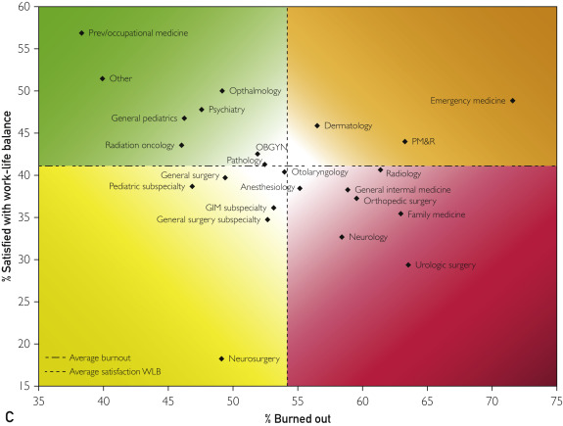

Figure 1
Mayo Clinic Proceedings 2015 90, 1600-1613DOI: (10.1016/j.mayocp.2015.08.023)
Copyright © 2015 Mayo Foundation for Medical Education and Research Terms and Conditions
Notes:
Burnout (A) and satisfaction with WLB (B) by specialty 2014 vs 2011. For 1A and 1B, specialty discipline is shown on the y axis and burnout (A) and satisfaction with WLB (B) are shown on the x axis. For 1C, satisfaction with WLB is shown on the y axis and burnout on the x axis. GIM = general internal medicine; OBGYN = obstetrics and gynecology; PM&R = physical medicine and rehabilitation; Prev = Preventive medicine, occupational medicine, or environmental medicine; WLB = work-life balance. ªP<.05 from comparison 2014 to 2011.

Slide 7
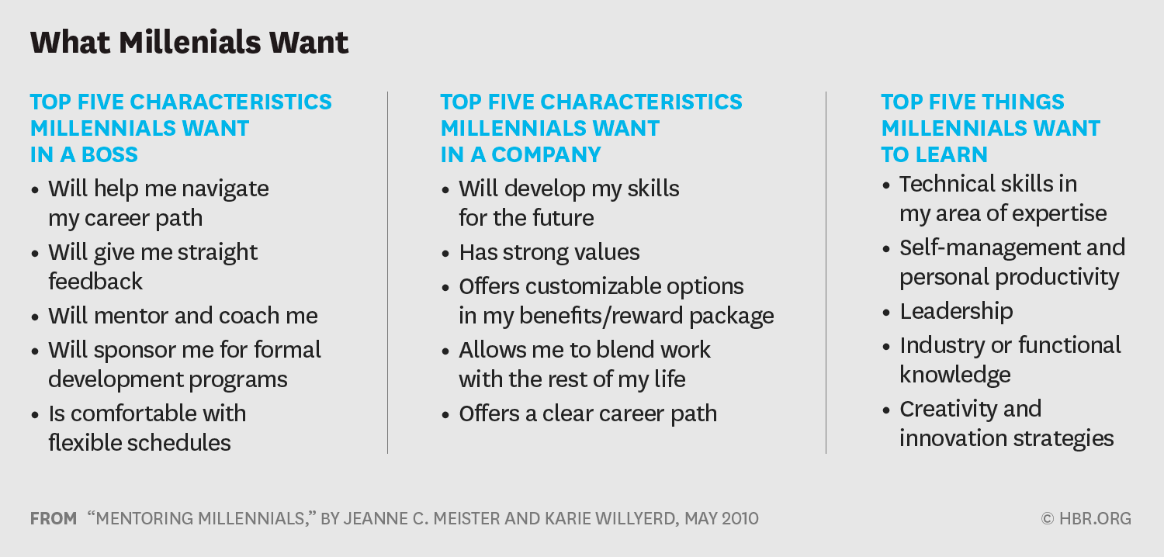
Notes:
Gen Y or Millenials late 1980”s

Slide 8

What is needed?
The Team
  Teacher
  Mentor
  Program Director

Slide 9
Types of Mentoring
    Direct Mentoring
    Reverse Mentoring
    Group Mentoring

Slide 10
Direct Mentoring
Classic one-on-one relationship.
Typically an older experienced mentor paired with a younger less experienced mentee.
Formal (part of an institution/employer/medical school mentoring program).
Informal or voluntary.
Many different types, names, styles (Peer, Cross-Age, Power Mentoring, etc).

Slide 11
Reverse Mentoring
Original idea came from GE CEO, Jack Welch, who established this type of mentoring to teach senior executives about the internet.
Exchange-style mentoring where older employees can modernize themselves by learning more about current technology and workforce trends (ex. apps, social media).
Found to also reduce turnover of the younger employees.

Slide 12
Group Mentoring
Usually led by a senior employee, MD, administrator, etc.
Defined target mentee audience.
Typically follows a standard format such as a routine meeting, conference call and/or lecture.
Less resource-intensive.
Less direct individual mentee impact.

Slide 13
Successful Mentoring
Mentee
Mentor
Organization
Lee PR and Marsh EB, Neurology 2014.

Slide 14
Institutional support
Tangible value
Training
Track outcomes
Levy et.al. Acad Med 2004
Strowd et.al. Neurology 2013
Jackson et.al. Acad Med 2003

Slide 15
Best Fit
Mentor
  Committed
  Consistent
  Admirable
  Balanced
Mentee
  Active participant
  Self-reflective
  Goal oriented
  Realistic
Cho et.al. Am J Med 2011.
Zerzan et.al. Acad Med 2009

Slide 16
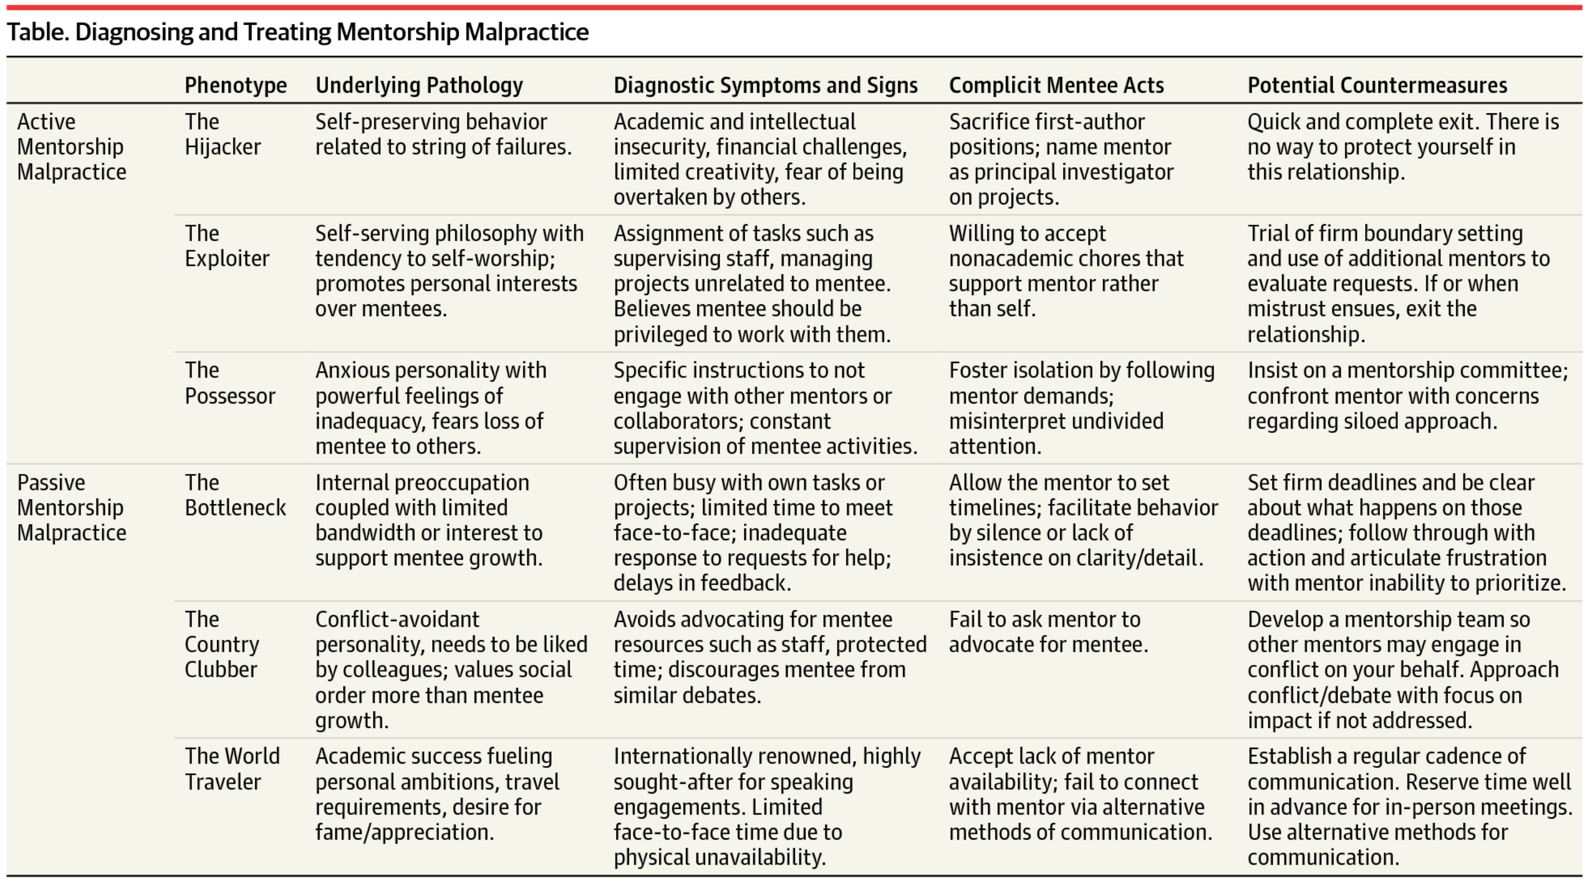
Mentoring Malpractice
Date of download: 4/13/2016
JAMA. 2016;315(14):1453-1454. doi:10.1001/jama.2015.18884
Copyright © 2016 American Medical Association. All rights reserved.

Slide 17
How are we doing?
Self-Study: Alumni SWOT analysis
  General career satisfaction
  Business of Medicine
  Local issues
Resident survey
2015-2016
2016-2017

Slide 18
Current approach
Hybrid
  Assigned
  Peer
  Selected

Slide 19
Goal
Bring interested faculty and residents closer
Formalize reporting of mentoring interactions
Review relationships semi-annually and program structure every 2 years
Enlist institutional support for mentors/mentoring programs

Slide 20
Tactics
Residents
  Assigned advisors for PGY-2
  Use of faculty profiles/early meeting to identify mentors
  Orientation in preparation for mentoring
    Goal setting
    Self-reflection
    Expectations
Mentors/advisors
  Late spring refresher of role definitions
  Attendance at meet/greet
  Collect/share best practices
  Encourage use of technology to improve meeting frequency

Slide 21
Next steps
Faculty profiles
Early meet and greet
Mentor recognition/incentives
Investigate with leadership (department, MC) opportunities for incentives
Evaluate relationships semi-annually; evaluate program yearly with every other year reports to faculty

Slide 22
Yehia et.al. BMC Medical Education 2014.
Notes:
Likert 1=strongly agree-3=neutral-5=strongly disagree
1=very positive 3=unsure 5=very negative

