Slide 1
Philanthropy:
Lessons Learned
Using philanthropy to support career development
David G. Standaert, MD, PhD
John N. Whitaker Professor and Chair of Neurology
University of Alabama at Birmingham

Slide 2
Disclosures
Dr. Standaert has served as a paid consultant to these companies within the last 12 months:
  Abbvie Inc.
  Sanofi-Aventis Research and Development.
  RTI Consulting
  Censa Pharmaceuticals
  Grey Matter Technologies
  Cerevance, Inc.
  Theravance, Inc
  AVRObio
No off-label use of medications will be presented.

Slide 3
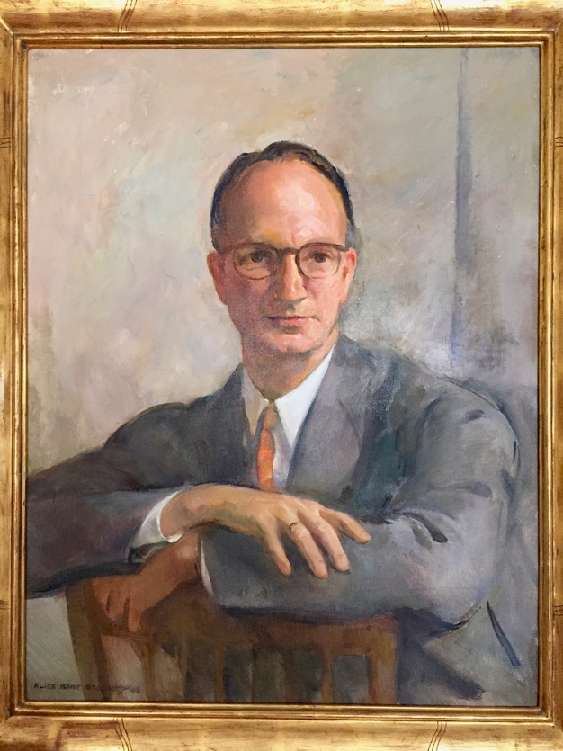
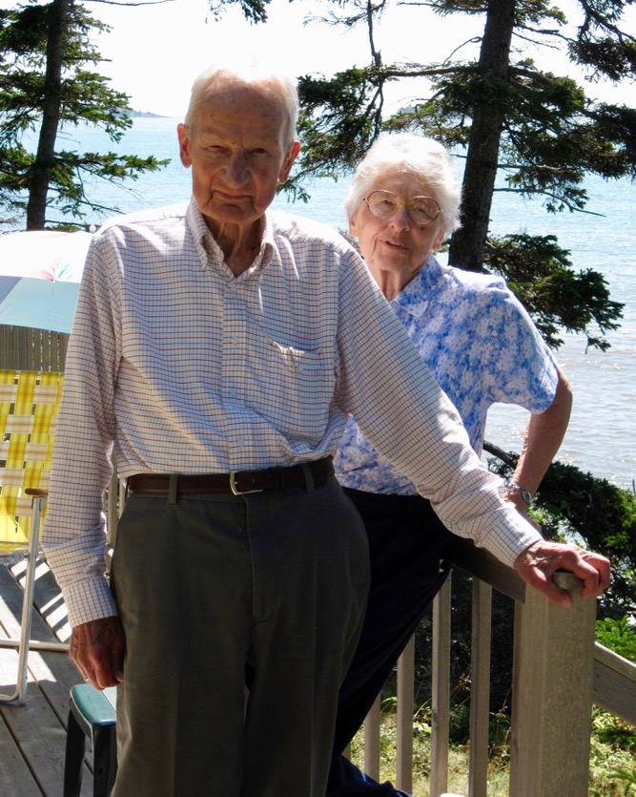
Dr. Francis Schumann 1914 - 2013
Harvard College class of 1935
U Penn Medical School
Flight Surgeon, US Army
Met Heide Jenisch in Berlin, and married after the war
Surgeon, Philadephia General Hospital
Retired to Machias, ME

Slide 4
Francis and Heidi Ingeborg Schumann fellowship in Parkinson diseaese
Supports fellows for two years of specialized training in PD research and/or treatment
Has been used for both MD and PhD fellows
Structure is flexible, can be combined with other sources
Only fixed requirement is that the fellow has to travel to Maine to visit the Schumanns

Slide 5
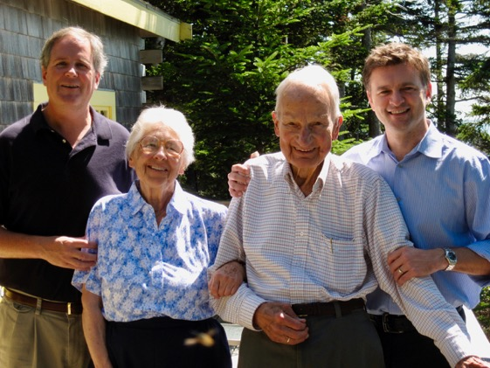
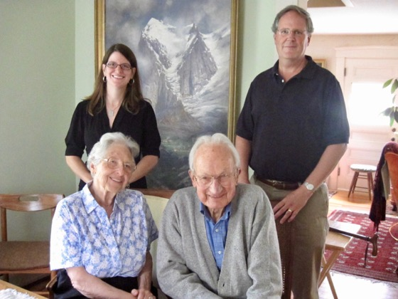
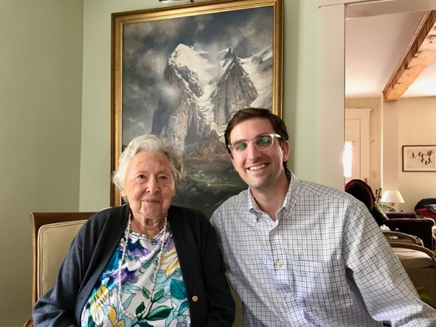
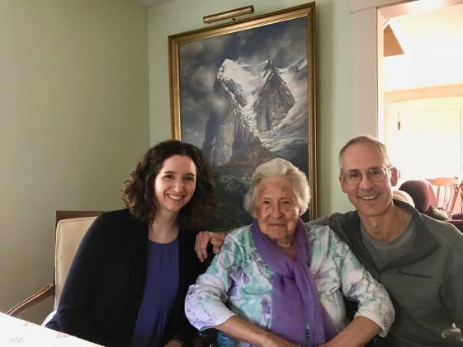
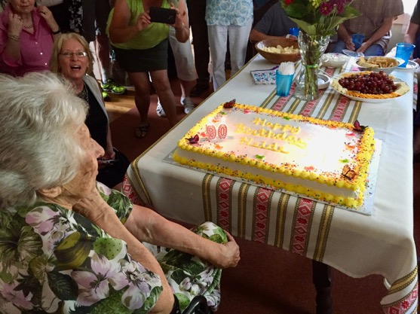
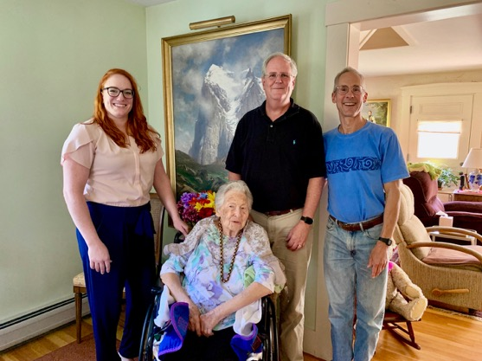
Schumann Fellows visit Machias

Slide 6
Schumann Fellowship
15 Fellows
$1,500,000 in fellowship support

Slide 7
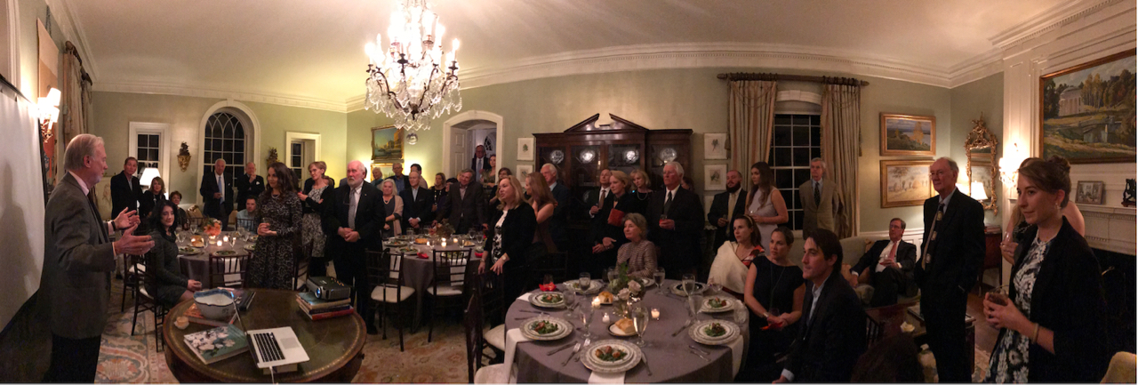
Parkinson Association of Alabama
Pre-doctoral Scholar
Funded by an annual cocktail event
supports a graduate student stipend and tuition for one year ($35,000)
More than 10 students supported so far

Slide 8
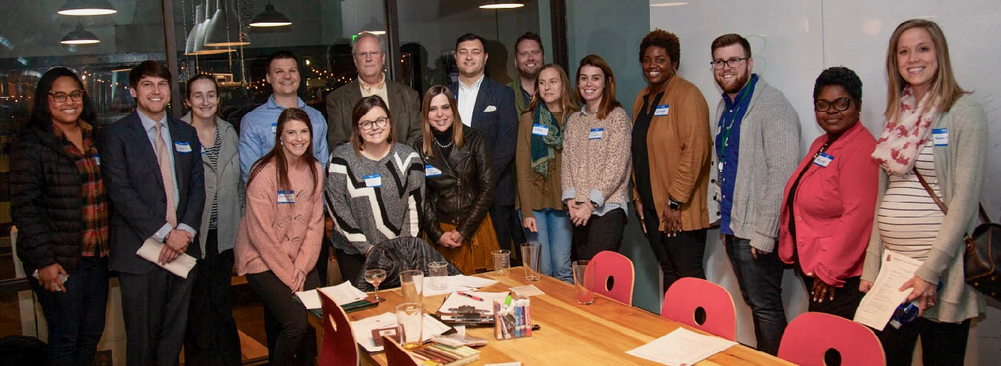
Alzheimers of Central Alabama
Predoctoral Scholar
Supports graduate student position
Tied to T32 selection process
Currently in first of two year commitment

Slide 9
Philanthropy for career development
The idea of supporting an identifiable person, rather than a project or equipment, is a powerful draw for some potential donors
A key part of building these relationships is letting the donors meet and get to know the individuals they are supporting
“Supporting a young scientist/physician is like planting a tree, it will continue to return benefits far into the future.”

