Slide 1
How to Get More Medical Students to Choose Neurology as a Career
AUPN Fall Chairs Session
Rachel Gottlieb-Smith, MD
Douglas Gelb, MD, PhD
University of Michigan

Slide 2
Gottlieb-Smith: no conflicts of interest
Gelb: no conflicts of interest

Slide 3
WHY SHOULD WE?
med students are grown-ups
they know what they like
they can decide for themselves if neurology is a good fit
every medical specialty does good
no medical specialty has too many practitioners
⇒ we should inform, not promote

Slide 4
WHY SHOULD WE?
med students are grown-ups
they know what they like
they can decide for themselves if neurology is a good fit
every medical specialty does good
no medical specialty has too many practitioners
⇒ we should inform, not promote

Slide 5
WHY SHOULD WE?
med students are grown-ups
they know what they like
they can decide for themselves if neurology is a good fit
every medical specialty does good
no medical specialty has too many practitioners
⇒ we should inform, not promote

Slide 6
WHY SHOULD WE?
med students are grown-ups
they know what they like
they can decide for themselves if neurology is a good fit
every medical specialty does good
no medical specialty has too many practitioners
⇒ we should inform, not promote

Slide 7
WHY SHOULD WE?
med students are grown-ups
they know what they like
they can decide for themselves if neurology is a good fit
every medical specialty does good
no medical specialty has too many practitioners
⇒ we should inform, not promote

Slide 8
WHY SHOULD WE?
med students are grown-ups
they know what they like
they can decide for themselves if neurology is a good fit
every medical specialty does good
no medical specialty has too many practitioners
⇒ we should inform, not promote

Slide 9
WHY SHOULD WE?
med students are grown-ups
they know what they like
they can decide for themselves if neurology is a good fit
every medical specialty does good
no medical specialty has too many practitioners
⇒ we should inform, not promote

Slide 10
WHY SHOULD WE?
med students are grown-ups
they know what they like
they can decide for themselves if neurology is a good fit
every medical specialty does good
no medical specialty has too many practitioners
⇒ we should inform, not promote

Slide 11
WHY SHOULD WE?
med students are grown-ups
they know what they like
they can decide for themselves if neurology is a good fit
every medical specialty does good
no medical specialty has too many practitioners
⇒ we should inform, not promote

Slide 12
WHY SHOULD WE?
med students are grown-ups
they know what they like
they can decide for themselves if neurology is a good fit
every medical specialty does good
no medical specialty has too many practitioners
⇒ we should inform, not promote

Slide 13
WHY SHOULD WE?
med students are grown-ups
they know what they like
they can decide for themselves if neurology is a good fit
every medical specialty does good
no medical specialty has too many practitioners
⇒ maybe we should promote a little while we inform

Slide 14
How do first-year students begin to make decisions about neurology?

Slide 15
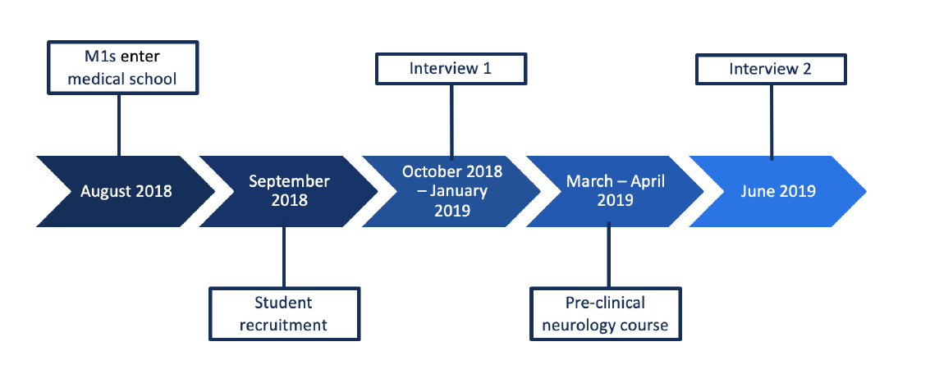
STUDY DESIGN

Slide 16
STUDY DESIGN
Interviews 1 and 2 were 1:1 semi-structured interviews with the same 15 M1s at the University of Michigan
Interview topics
Career intentions
Factors influencing career choice
Perceptions of neurology
Change over time (interview #2)

Slide 17
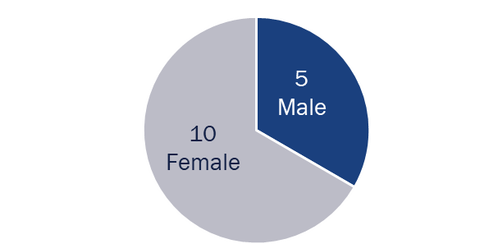
PARTICIPANTS
Interview 1
Interview 2
2 Neurology Inclined
1 Neurology Inclined
1
9 Neurology Neutral
11 Neurology Neutral
1
4 Neurology Disinclined
3 Neurology Disinclined

Slide 18
RESULTS: TOP FACTORS
“Fixing”/”curing” the problem (7%)
Research (7%)
Personality of specialty (6%)
Performing procedures (5%)
Lifestyle (27%)
Patient population (8%)
Personal interest (20%)
Impact (9%)
Relationships with patients (11%)

Slide 19
RESULTS: LIFESTYLE
What it means
“I think lifestyle and time for family are the same thing to me.” (P9-2)
Child bearing / parental leave
Work hours
Flexibility
What it doesn’t always mean
I’m not really driven by how much--compensation. I feel like that’s not a factor really for me.” (P8-1)

Slide 20
NEUROLOGY & LIFESTYLE
“I honestly have no idea about lifestyle in neurology.” (P2-2)
Surgical v. non-surgical
“It would be a lot easier than maybe some other specialties, like surgical specialties, to balance family life and have a consistency of your day.” (P3-2)

Slide 21
RESULTS: PERSONAL INTEREST
What it means
“Intellectual stimulation”
“Passion”
“Excitement”
May increase in importance over pre-clinical curriculum
“How have my thoughts changed? My interest in the field is much more important. When we last spoke, I didn’t know all the fields or go through all the fields. Now I have an idea of kind of what I find interesting.” (P6-2)

Slide 22
NEUROLOGY & PERSONAL INTEREST
Generally neutral/positive
Typically increased over time
The unknown: +/-
I feel like my perception is that there’s a lot of stuff going in neurology that’s new and that requires innovative ideas and might be challenging and push you to think outside the box. So that, I think might align with my interest and what I’m looking for in terms of creative problems.” (P12-1)
My issues with neurology is it’s a little bit scary for me because we don’t have and don’t know so much about how the brain works. And while maybe some people might be really intrigued, and motivated by that, I’m almost scared by that.” (P9-1)

Slide 23
CONCERNS ABOUT NEUROLOGY
Fixing/curing the problem
“And I feel that some of the things in neurology are problems… that can’t really be fixed. It’s more of a palliative specialty. And I think for me that would be something more emotionally hard to deal with.” (P11-1)
A little less in interview 2: “But it seems like there are actually interventions and things that people are able to [make] some difference in.” (P11-2)
Neurology as “difficult”: +/-
6 in interview 1 →10 in interview 2
Course difficulty + limited time may contribute to burnout

Slide 24
SO WHAT TO DO?
Introduce role models with good work-life integration
Emphasize the positive impact, including some “fixes”/”cures”
Increase time in pre-clinical neurology course
Other student suggestions: clinical correlations, research opportunities

Slide 25
RESEARCH TEAM
Douglas Gelb, MD, PhD
Dorene Balmer, PhD
Benjamin Becker, MD
Braydon Dymm, MD
Olivia Gutgsell, MD
Namrata Patel, MD

