Slide 1
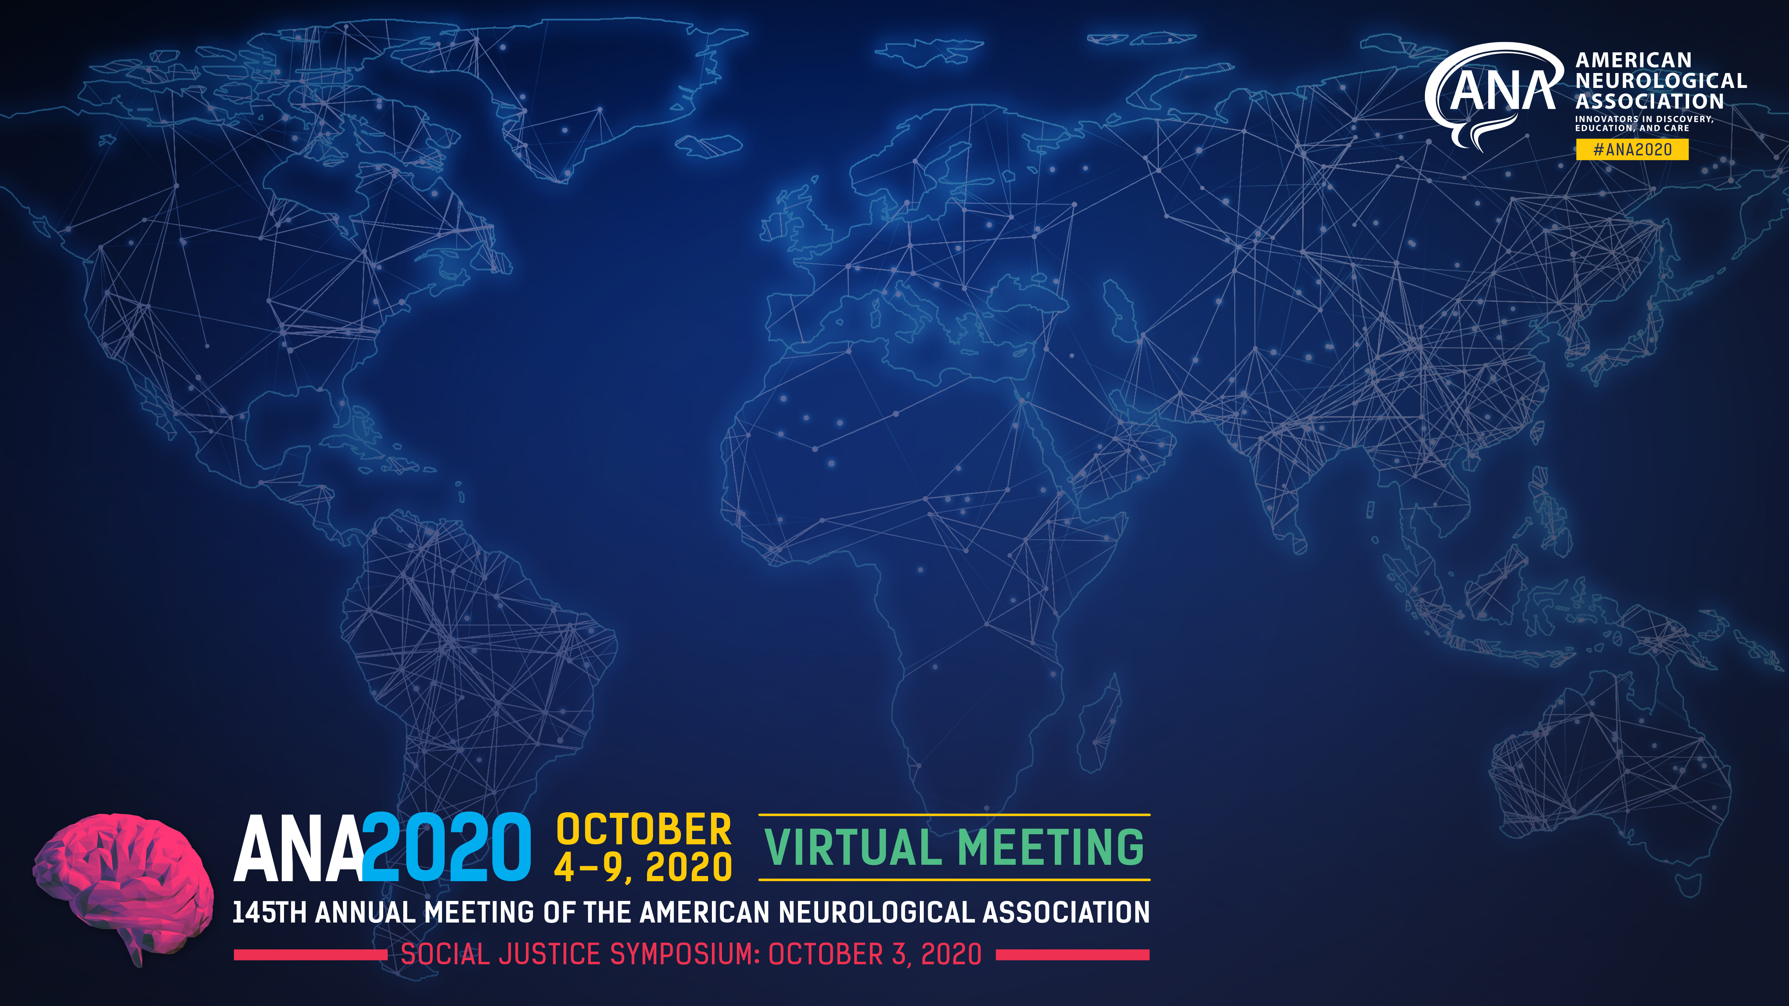
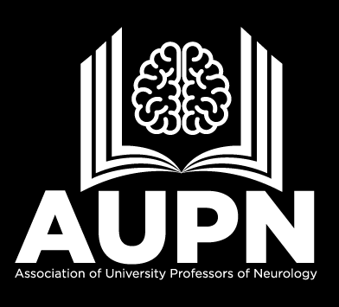
Session
AUPN Fall Chairs Session
Imran I Ali MD
Professor and Clair Martig Endowed Chair of Neurology
UT COM LS

Slide 2
Director, American Board of Psychiatry and Neurology

Slide 3
Objectives
Describe the scope of the problem related to future neurology workforce and its relationship to training of students and residents.
Review literature as it pertains to Neurophobia.
Review the literature related to best practices in medical school training and its impact on career choices (neurology).

Slide 4
Neurology Work Force Projection
Neurology 2013;81:470–478

Slide 6
NRMP Match Data 2020
Preferred Specialty | Total Positions Offered | Total Number of All Applicants | Number of All Applicants Per Position | Number of US MD Seniors _____________ Matched Not Matched Total | US MD per position
Neurology | 946 | 1068 | 1.13 | 458 13 471 | 0.5
Neurosurgery | 232 | 383 | 1.65 | 203 67 270 | 1.16

Slide 10
Neurophobia
First described by R. Jozefowicz
      Arch Neurol 51;328-9:1994
  Related to perceived difficulty
  Lack of knowledge of specialty (lowest ratings)
  Lack of basic/clinical science integration
  Quality of teaching

Slide 12
Themes
  Early and broad clinical exposures
  Preclerkship experiences and neuroscience curriculum
  Interactions with neurologists
  Stereotypical neurologists, patients and perception of treatment options

Slide 13
Addressing the problem
Address Neurophobia
  Integrate basic and clinic neurology
  Curricular leadership
  Introduce clinical neurology early
  Focus on common neurological disorders
Student engagement
Mentorship
Quality of teaching

Slide 15
Predictors of a career in Neurology
Excellent rating of Neuroscience course
Rating of Neurology clerkship (Odds ratio 2.31, 95% CI, 1.98-2.69)
Quality of faculty and resident teaching
MD/PhD program
Interest at matriculation

Slide 16
Change in primary teaching site
Year 4 3
UT Department of Neurology Clerkship Data 2004-2020

Slide 18
Magnitude of the problem-
Conclusions
There is a need for more neurologists
Number of US seniors matching has remained unchanged at 2.8-3.0%
Best practices need to be widely adapted to address gaps

