Slide 1



How to Foster Development of Junior Faculty
AUPN Fall Chairs Session
Barbara G. Vickrey, MD, MPH
Professor and Chair of Neurology, Icahn School of Medicine at Mount Sinai

Slide 2
None

Slide 3
Junior Faculty Development
Context at ISMMS Neurology in NYC:
Chair for 5 years
132 neurology faculty
4 (3%) instructors
72 (55%) assistant professors
25 (19%) associate professors
31 (23%) professors
22% - Investigator track, 45% - Clinician-Educator track, 19% - Clinical Practice track, 14% -
Research track
53 residents (2 programs), 20 fellows, 34 post-docs
Have recruited 58 faculty since April 2016
large-sized multi-campus department in a metropolitan area,
with many other nearby AMCs

Slide 4
Junior Faculty Development
Setting Expectations – Use of Vision Statements
Securing Resources for the Different AMC Missions
Supports for Clinician-Investigators
Supports for Clinician-Educators
Career Development and Women Faculty
Finding Good Mentors; Fostering Useful Relationships
Annual Review and Beyond

Slide 5

Setting Expectations – Use of Vision Statements
As said in preceding presentation, it is essential to have a thoughtful, iterative process during recruitment to align expectations
Remind the recruit that the premise starts with both parties having a vested interest in enabling that recruit’s success
For the recruit: the process is an opportunity for professional reflection, planning, and exploration of alignment of interests
Let the recruit know that the institution’s process for developing an offer often involves the Chair making a business case to multiple stakeholders (ie dean, hospital, institute director, other chairs)

Slide 6

Setting Expectations – Use of Vision Statements
Your professional goals:
  Over initial or next 3 years
  Overarching, long-term
Exploration of these goals’ alignment with that of the institution
Preferences and degree of importance
Data/benchmarks

Slide 7
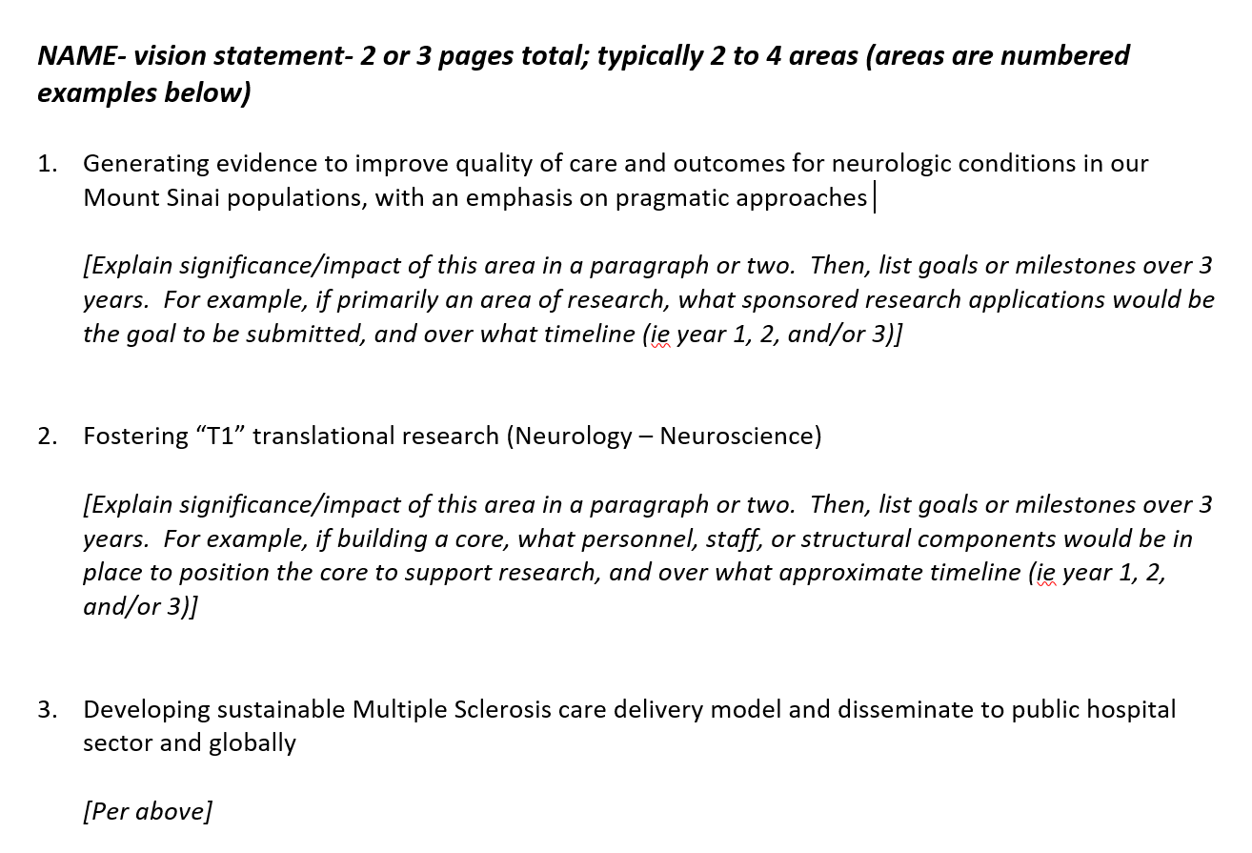
Example: Vision Statement as a Roadmap to 3-year Academic Goals and Resources Needed to Attain Them

Slide 8
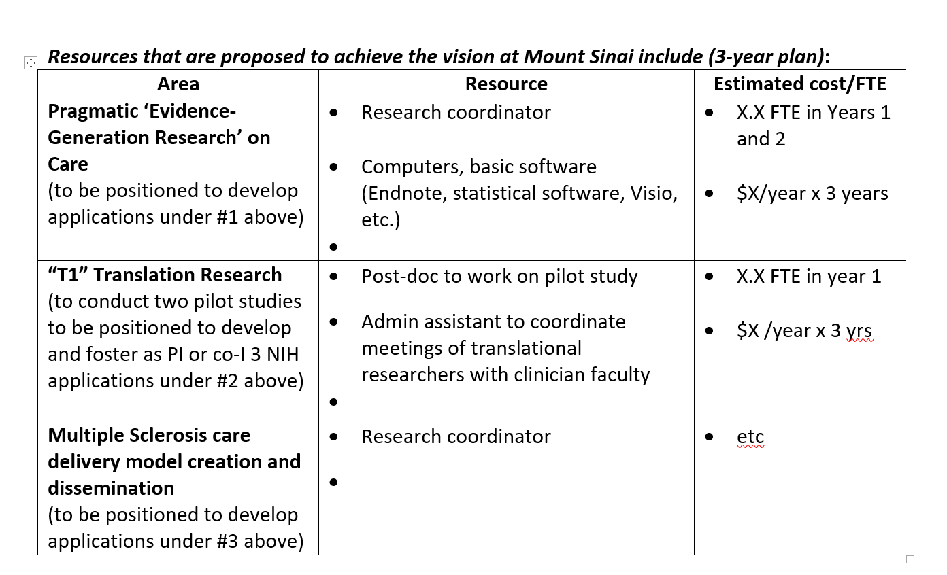
Example: Vision Statement as a Roadmap to 3-year Academic Goals and Resources Needed to Attain Them
We use the vision statement and the resource table mapped onto it, as well as the projected timeline for grant applications (or equivalent), to develop (1) a detailed, academic-mission bucketed position description, and (2) our business plans for resource requests.

Slide 9
Securing Resources for Different AMC Missions
Make the value as explicit as possible – this is where a thoughtful and well-developed vision
statement is key; try to include well-justified faculty development resources at this stage
A research ROI from indirect projections is required for all clinician-investigator
applicants with research seed needs
Align with other Chairs or units, where applicable, ie, Neurosurgery, informatics, Pediatrics,
an affiliated site
The tin cup; refining the ask

Slide 10
Supports for clinician-investigators
Mentoring Committee – Chair/Division Chief should actively track/help schedule
Notes and follow-up for next meeting
At least quarterly
Special challenge of mentors in another department
Junior faculty internal peer review of grant applications
Chair check-ins
Keep ‘Ear to the ground’/remove barriers to your access for problems that arise

Slide 11
Supports for clinician-educators
Tougher to address as fewer precedents and lesser resources/rewards to mentor
Much more variable ‘phenotype’ as it includes residency program leadership,
clerkship leadership, site hospital or campus leadership (clinical
administrative), program development, clinical informatics, etc
Best opportunities may be internal institutional courses, scholarships, or programs
(but need protected time) as well as external enrichment activities from
professional societies. Barrier is time of finding good fits and applying.
Probably should have a Mentoring Committee in some instances

Slide 12
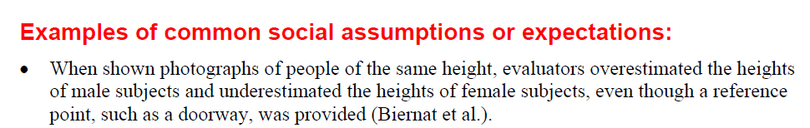

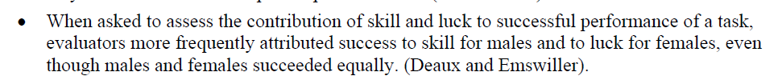
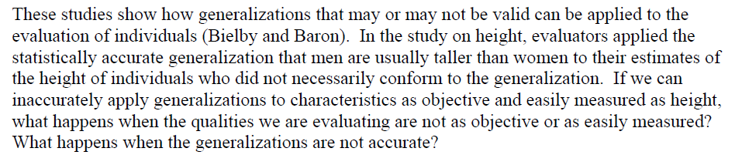
Career Development and Women Faculty
https://wiseli.wisc.edu/wp-content/uploads/sites/662/2018/10/BiasBrochure_3rdEd.pdf

Slide 13
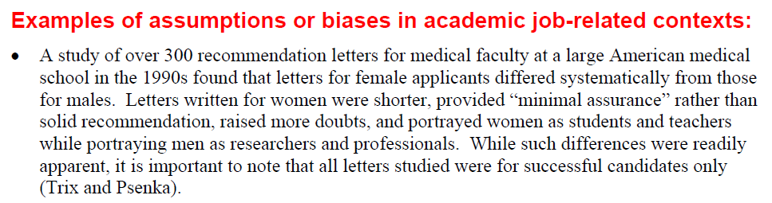
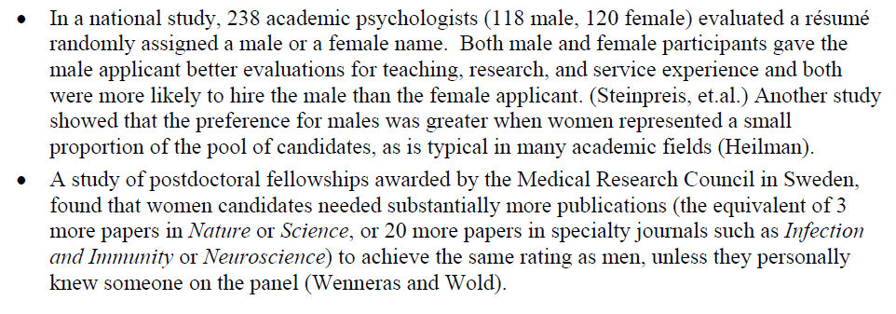
https://wiseli.wisc.edu/wp-content/uploads/sites/662/2018/10/BiasBrochure_3rdEd.pdf

Slide 14
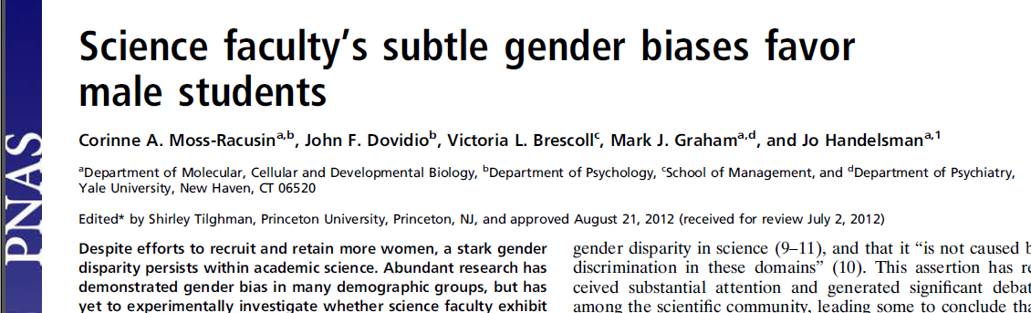
“A broad, nationwide sample of biology, chemistry, and physics professors (n = 127) evaluated the application materials of an undergraduate science student who had ostensibly applied for a science laboratory manager position. All participants received the same materials, which were randomly assigned either the name of a male (n = 63) or a female (n = 64) student; student gender was thus the only variable that differed between conditions”
Moss-Racusin, et al, PNAS | October 9, 2012 | vol. 109 | no. 41

Slide 15
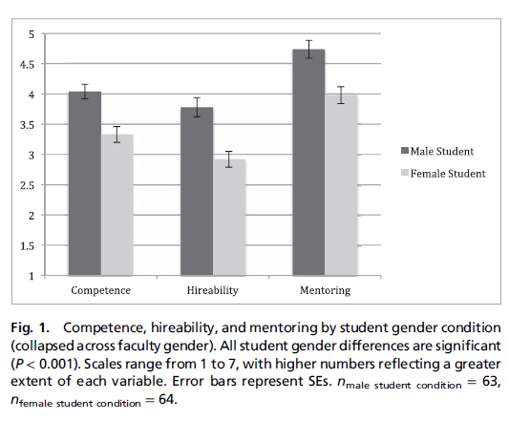
Moss-Racusin, et al, PNAS | October 9, 2012 | vol. 109 | no. 41

Slide 16
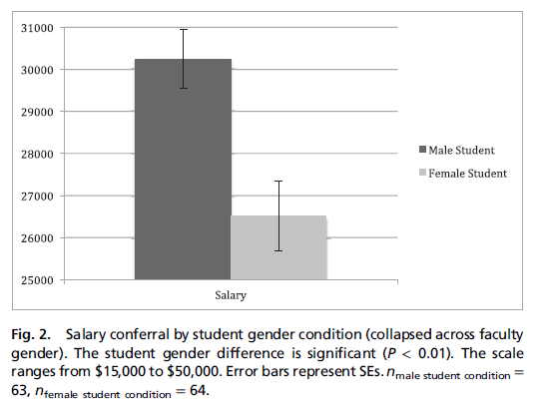
“The mean starting salary offered the female student, $26,507.94, was significantly lower than that of $30,238.10 to the male student [t(124) = 3.42, P < 0.01]”
Moss-Racusin, et al, PNAS | October 9, 2012 | vol. 109 | no. 41

Slide 17
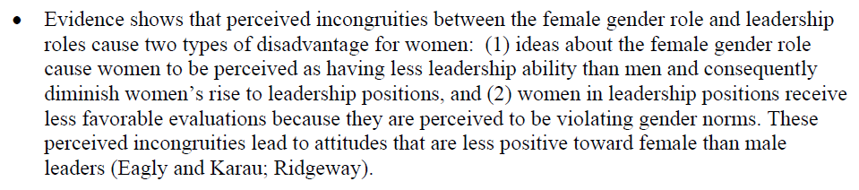
https://wiseli.wisc.edu/wp-content/uploads/sites/662/2018/10/BiasBrochure_3rdEd.pdf

Slide 18

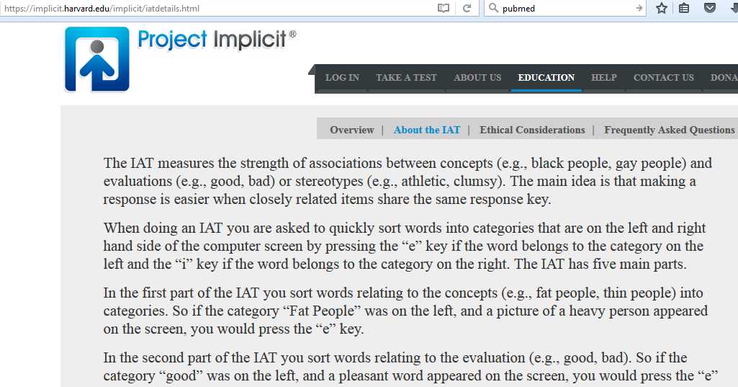
Biases and assumptions are pervasive.
A book written to raise our capacity to think deeply not only about science but also about our professional life and interactions.

Slide 20

Gaining a New Perspective
Study of a cohort of Carnegie Mellon business school graduates (page 2)
  Starting salaries of men graduates were 7.6% higher than women
    Digging deeper, 57% of the men compared to 7% of the women had asked for more money after receiving the initial offer, explaining nearly all of the difference
Salary negotiation and gender differences in how one’s ‘worth’ is determined (page 35):
  Of those who assumed they determined their worth, 85% of men and 17% of women were in this category
  Of those who felt their worth was determined by what the company paid, 15% of men and 83% of women interviewed were in this category
Copyright 2007, Bantom

Slide 21
Kalev, Dobbin & Kelly (2006)
This study matched survey data on employment practices with longitudinal data on the workforce composition of 708 establishments from 1971 to 2002 to explore the effects of practices designed to establish organizational responsibility for diversity, practices designed to moderate managerial bias through education and feedback, and practices designed to reduce the social isolation of women and minority workers.
The results found that efforts to moderate managerial bias through diversity training and performance evaluations are least effective, efforts to attack social isolation through mentoring and networking show modest effects, and efforts to establish responsibility for diversity lead to broader increases in white women, black women, and black men in management. The authors found that programs that establish organizational responsibility (affirmative action plans, diversity committees, and diversity staff) are the most effective means of increasing the proportions of white women, black women, and black men in private sector management.

Slide 22
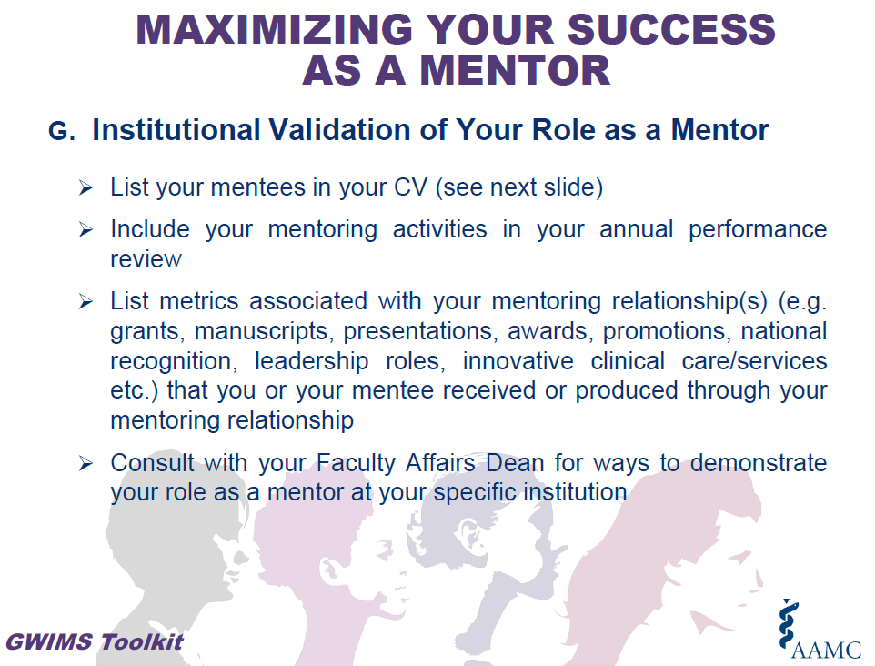
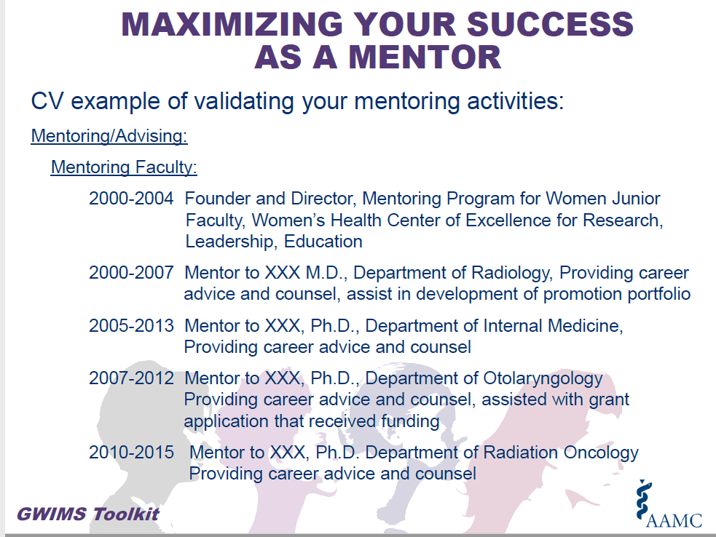
Incentives for effective mentoring

Slide 23
Limitation of Metrics to Evaluate Research Mentoring
Most straightforward metric is publication with mentees
However, that may not reflect the quality of mentoring
Further, the 1:1 nature of mentoring makes it more challenging to identify problems except through absence of positive feedback or lack of evidence of ongoing interactions

Slide 24
Finding/Cultivating Effective Mentors
“Elevating mentorship to a strategic priority requires a merging of top-down and grassroots approaches. Academic leaders must communicate to constituents, by example and through financial support, that mentoring is an institutional priority, an evidence-based investment in the organization’s future, and a noble endeavor…”
“Incentives for faculty and departments to support such efforts include relief from dean’s and other institutional taxes, awards for mentoring excellence, consideration of mentorship in faculty promotion criteria, and financial supplements for department and division heads who successfully develop tailored plans for the career advancement of faculty members…the return on investment could be substantial.”
Choi AMK, Moon JE, Steinecke An, Prescott JE. Developing a culture of mentorship to strengthen academic medical centers. Academic Medicine 2019;94:630-633.

Slide 25
The Annual Review and Beyond
Important to find the time to make it a meaningful activity
It may represent a lot of your time as chair but each appraisal is potentially very powerful and precious to that faculty member, especially junior faculty
We use the school’s template and incorporate data that is also made transparent to the faculty
This past year we developed and rolled out a more systematic approach and training of division chiefs
Referrals to our department AP committee come out of the yearly review process
Review of prior year teaching appraisals and ‘cup of coffee’ feedback as relevant is a new process also related in time to the annual appraisals
Some resource needs are identified for follow-up by department
Very time-consuming

Slide 26
Junior Faculty Development Takes a Committed ‘Village’
“Dr. {} helps his trainees stay organized and on track with projects, maintains every commitment he makes to project completion, and responds to emails and other trainee requests in record time. Dr. {} has had the single greatest impact on my own research interests...and thanks to his mentorship I am in the process of applying for mentored career development research funding.”

